Slide 1
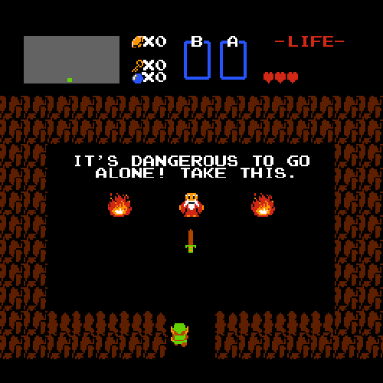
Games Development
Jesús Sanz, Javier García, Daniel García, Alejandro Gómez, Juan Miguel Sanz y Agustín Prieto
Notes:
Ohhh yeah
Animation: from “The legend Of Zelda”, when Link takes the sword at the beginning of the game.

Slide 2
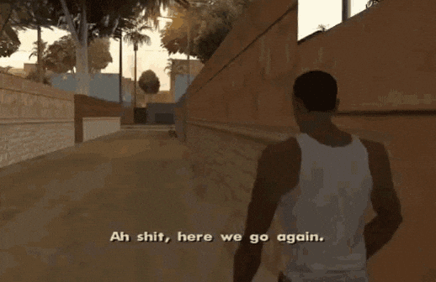
Index
Introduction
Getting Started
Technicals
UI vs UX
Visuals
Artwork
Color
Accesibility
Layout
Menus
Mockups
HUD
Conclusion
Notes:
Animation: from “GTA San Andres”, the meme of the beginning of the game.

Slide 3
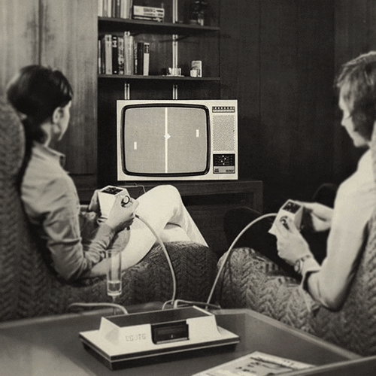
Introduction
66 years ago!!!
October 1958 William Higinbotham with a videogame of tennis similar to pong.
In 1961 Steve Russell with Spacewar!
Notes:
William Higinbotham created the game “Tennis for two” in 1958.

Slide 4
Getting Started

Slide 5
How does game development begin?.
2. Design Process.
..
3. Design for the Senses.

Slide 6
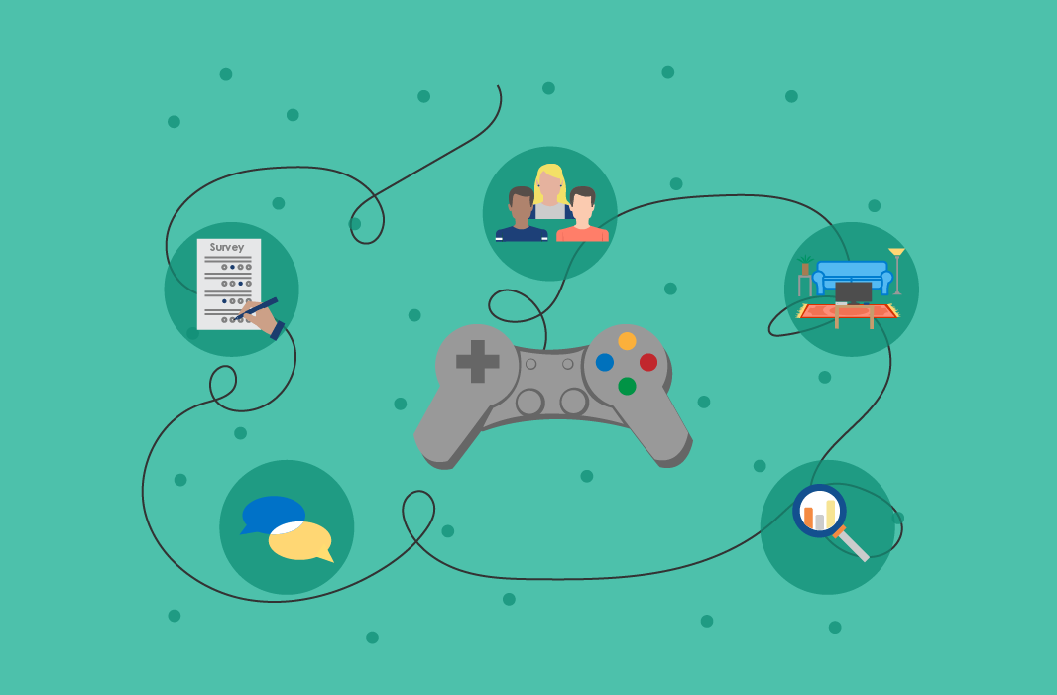
Game development is based on 3 main pillars:
Research involves seeking inspiration from movies, series, and comics while exploring the game's concept, design, and target market.
Personality refers to the core elements of the game, like shapes, icons, and typography, which should be unique to make the game more appealing.
Perception, including the emotions and reactions it evokes, such as how they experience movement or the game’s scenery.

Slide 7
Getting Started-Summary
The key elements when designing a video game need of researching ideas and themes, be creative and different if you want to stand out, and last but not least, how players feel when playing the game and the emotions between them. Detailing a little more:
Establishing the pillars of the game’s UI is vital, gathering data and understanding the nature of the game, its creative and art direction, and the target market, as well as making it all collaborate between them. Using references from movies, series, comics…are also quite important.
The product and the core components of the game as shapes, icons and typography have to be different to others, being unique makes it more attractive.
Testing motion and the interaction between player and game to ensure that the game theme and gameplay are understood, how the player feels when playing or if the movement is comfortable.

Slide 8
How does game development begin?.
2. Design Process.
3. Design for the Senses.

Slide 9
What is the difference between these two?
When designing UI (user interface) for a game, some potential problems may appear, like confusing text and graphics, information overload, short-live trends…That’s why we have to differentiate what is art and design and understand them.
Art Direction: “Does it feel good?”
This adds humanity and substance to the design, helping to tell a story to the targeted audience and creating an emotional connection with them.
Cognitive design: “Does it look good?”
This validates if the visual effect given by the art direction is functional, focusing on the technical execution of topics based on the use of color, composition and legibility.
Notes:
UI: is what the users can directly interact inside the game.

Slide 10
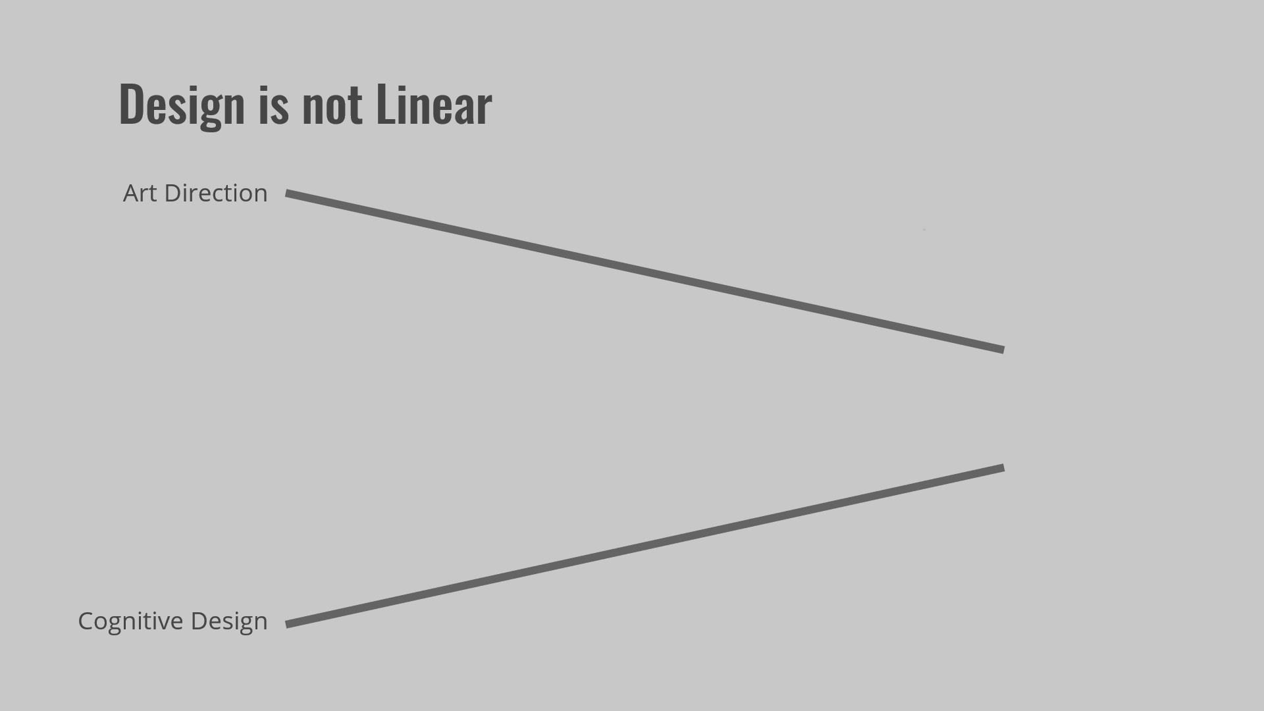
Design Process
Design is not linear, actually it gets messy and needs of refinements, even tossing good ideas during the process, then it should be balanced between form and function.
The placement of the UI has to be legible and do not interrupt the experience.
Avoid displaying information outside the safe action zone or show too much information.

Slide 11
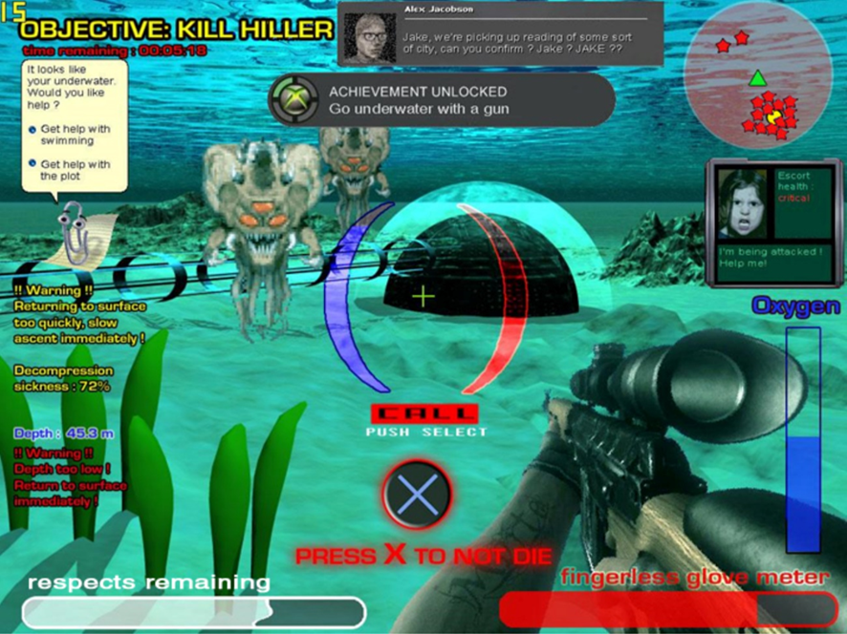
WHAT NOT TO DO

Slide 12
How does game development begin?.
2. Design Process.
3. Design for the Senses.

Slide 13
The main senses
Touch is vital as it is how we directly interact with the game (controllers, mousepads, keyboards…) then the design has to feel comfortable and natural even with its limitations.
Sound is the 50% of the UX (user experience), often implemented at the end of production and is not used as effectively as it could be.
Sight is the most exploited, setting the mood of the gameplay and is the most captivating.
Notes:
UX: user experience

Slide 14
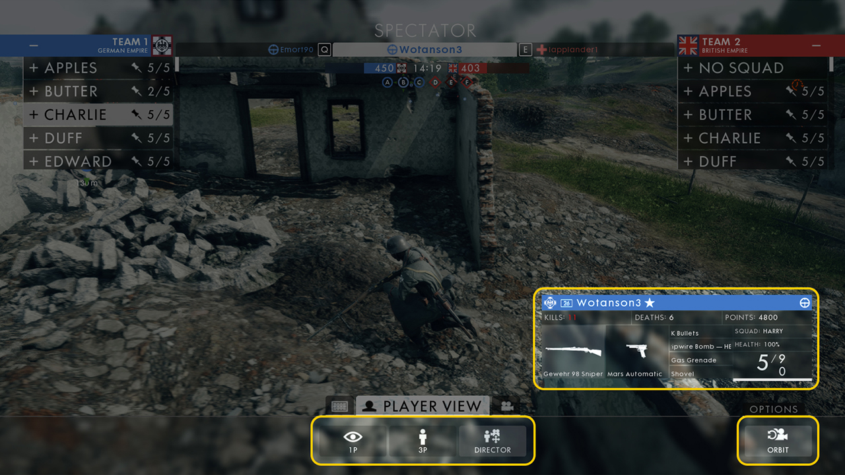
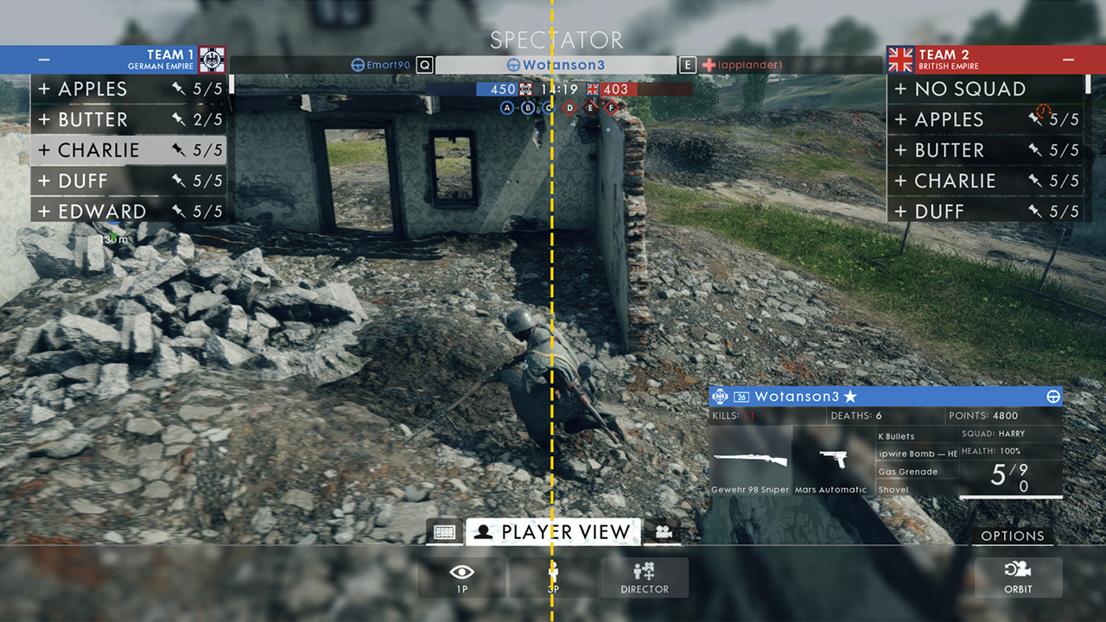
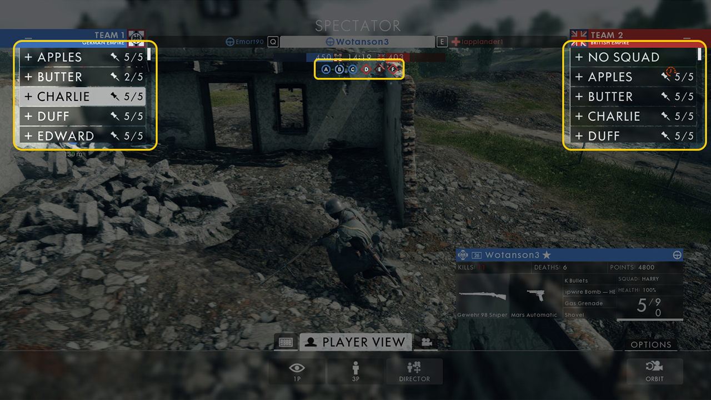
Design around perception (Gestalt Theory)
When designing, we must take into account how the human brain interprets the UI.
-Proximity
-Enclosure
-Symmetry
.
.
.

Slide 15
Technicals

Slide 16
Software.
2. Requirement checklist.
3. Tutorials.

Slide 17
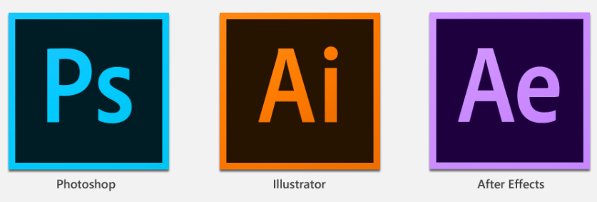
Technical

Slide 18
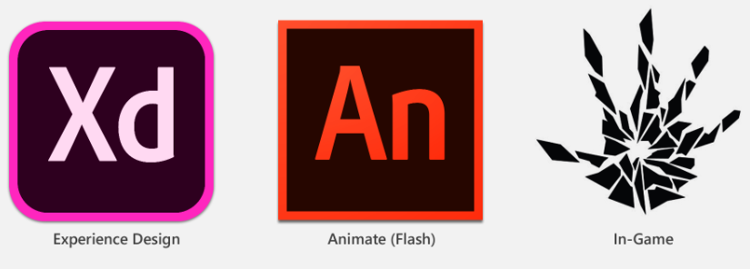
Technical

Slide 19
Software.
Requirement checklist.
Iconography.

Slide 20
Technical
Screen size Language support
Input controls Region ratings
Accessibility features Accessibility
Loading times …
Requirements specific to 4K, HD, and SD
Minimum font size
Input controllers

Slide 21
Software.
Requirement checklist.
Tutorials.

Slide 22
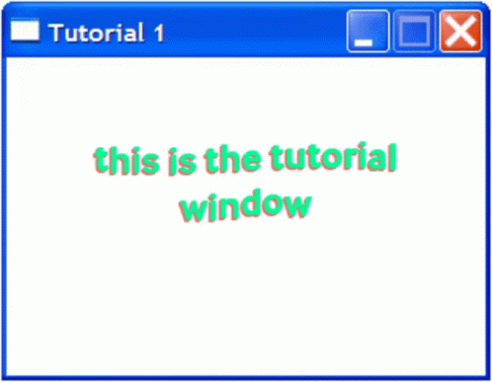
Technical
Pop-ups Sandbox level
Prompts Scripted tutorials

Slide 23
UI vs UX

Slide 24
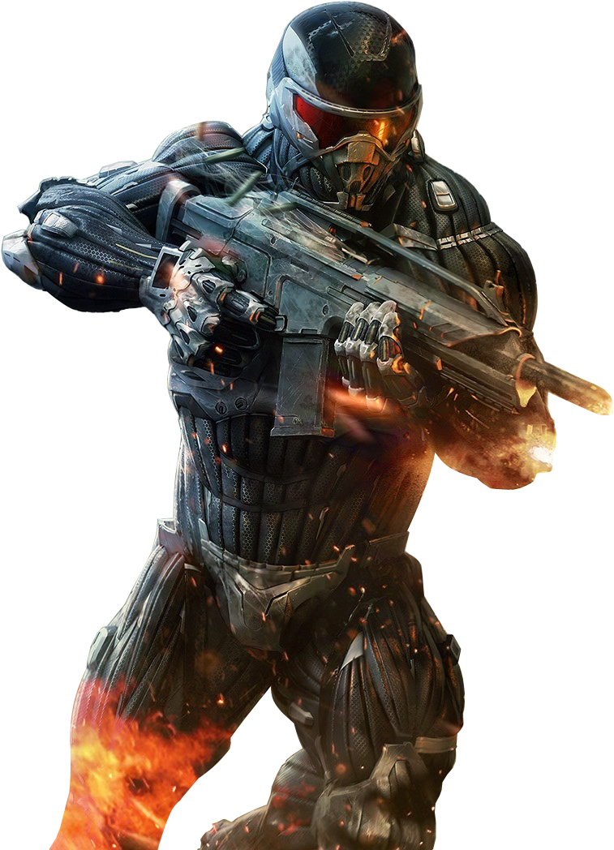
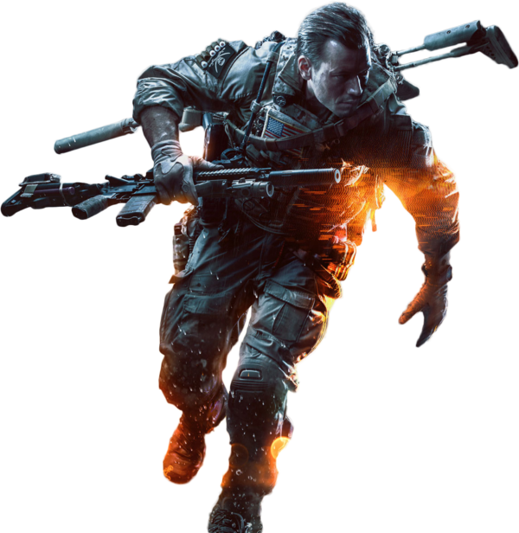
UI vs UX
UI: User interface. Interact and communicate with the system. Effective and clear
-Front-end (FE) menus: Where we interact, out of gameplay
-Heads-up display (HUD): In-game messages. Guide the player
UX: User experience, how the player feels. Interaction, design, marketing, post-purchase support…

Slide 25
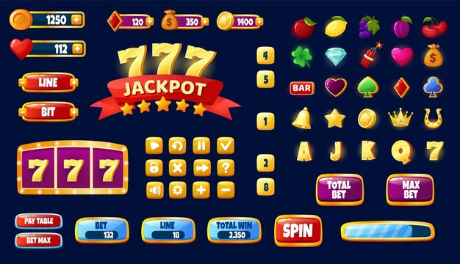
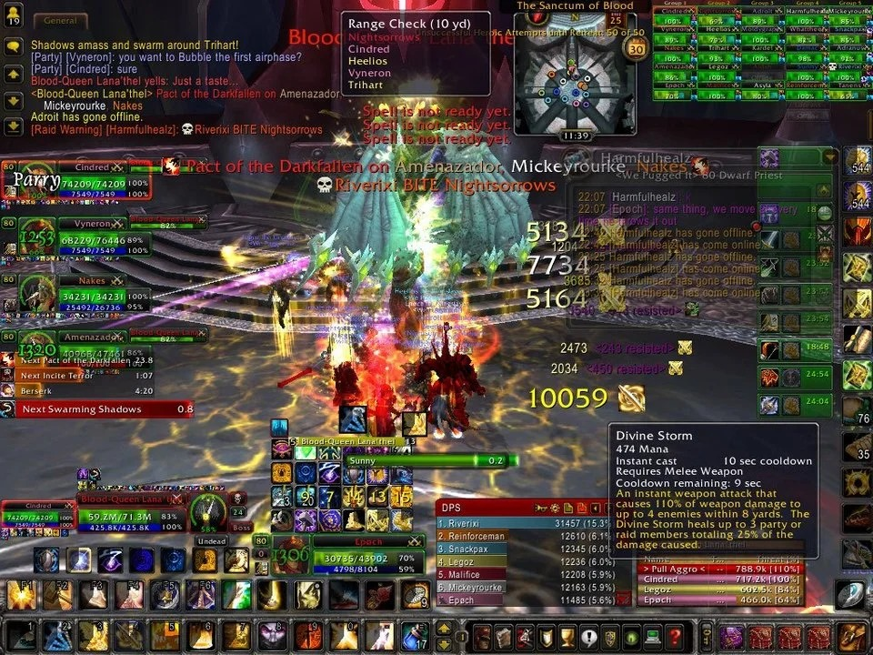
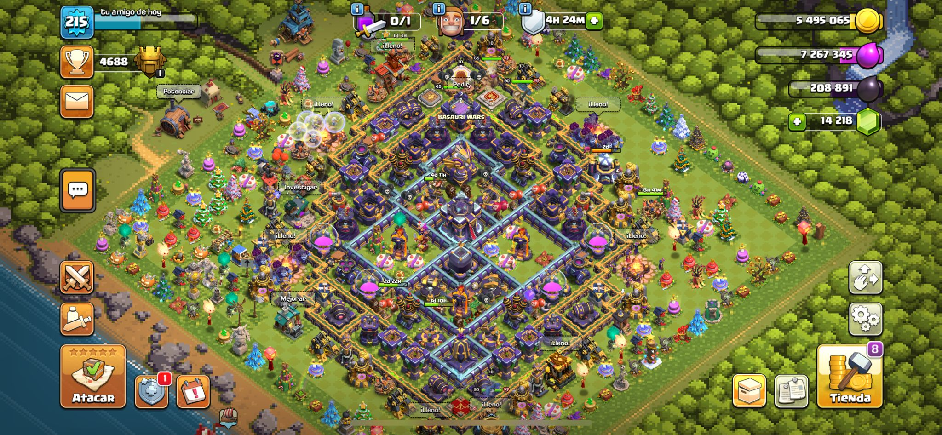
UI vs UX

Slide 26
Visuals

Slide 27
Focus states.
2. Shape language.
3. Iconography.

Slide 28
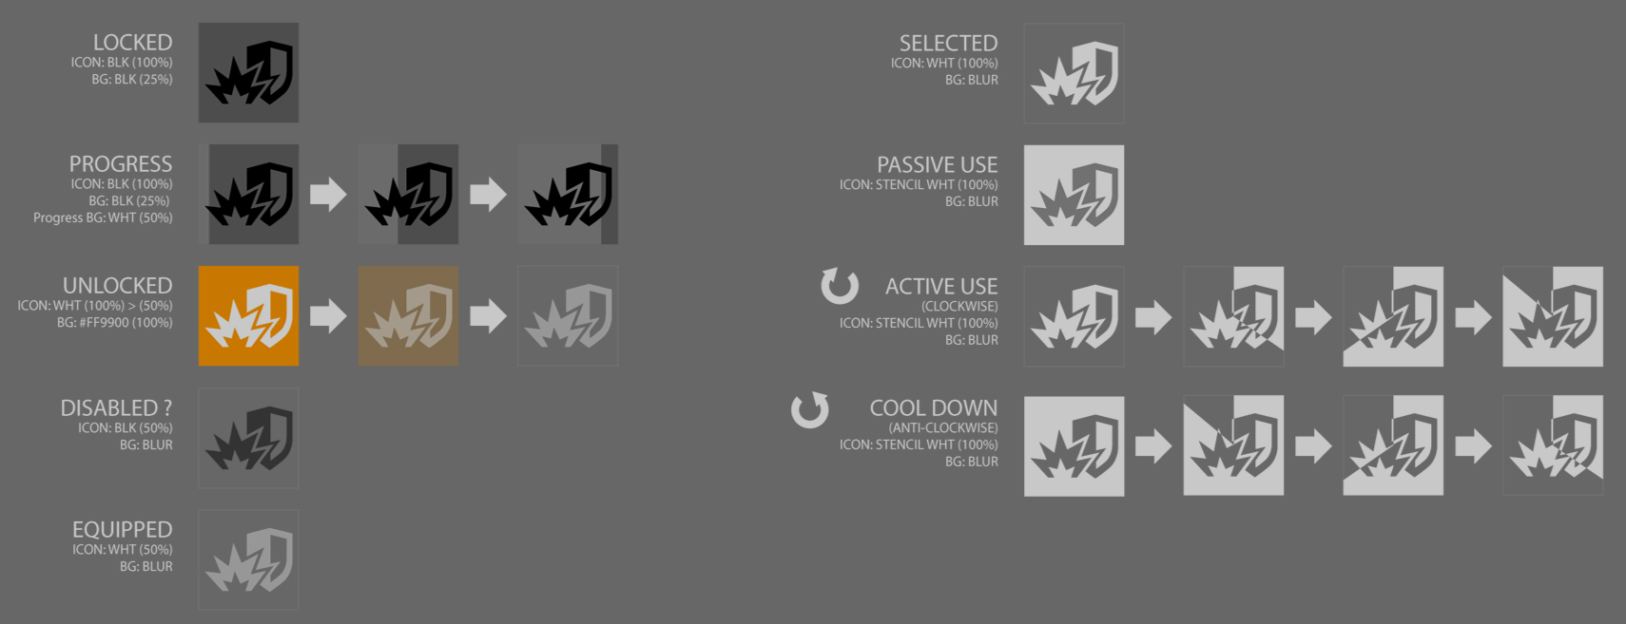
Visuals
Focus states: similar to pop-ups to be notice to the user. Types seen below.
All based on clarity, color schemes, and shape language on icons, pictures, buttons, sliders, notifications…

Slide 29
Focus states.
Shape language.
Iconography.

Slide 30
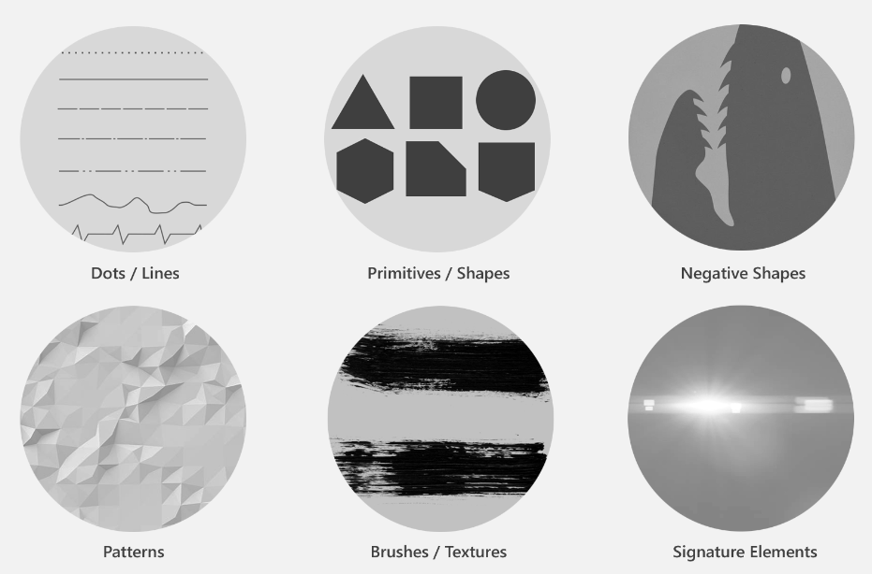
Visuals
Shape language: visual identity and harmony, low to high fidelity, guiding style consistency and cognitive clarity
Components: dots, shapes, textures…

Slide 31
Focus states.
Shape language.
Iconography.

Slide 32
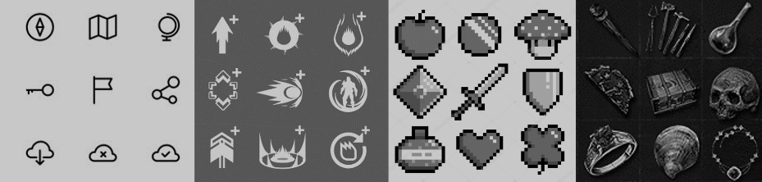
Visuals
Iconography: Basic rules are minimum screen size, simple and varied, 1”x1” size
Same style for the icons, getting the meaning and not being ambiguous. Easy readability and balanced.

Slide 33
Artwork

Slide 34
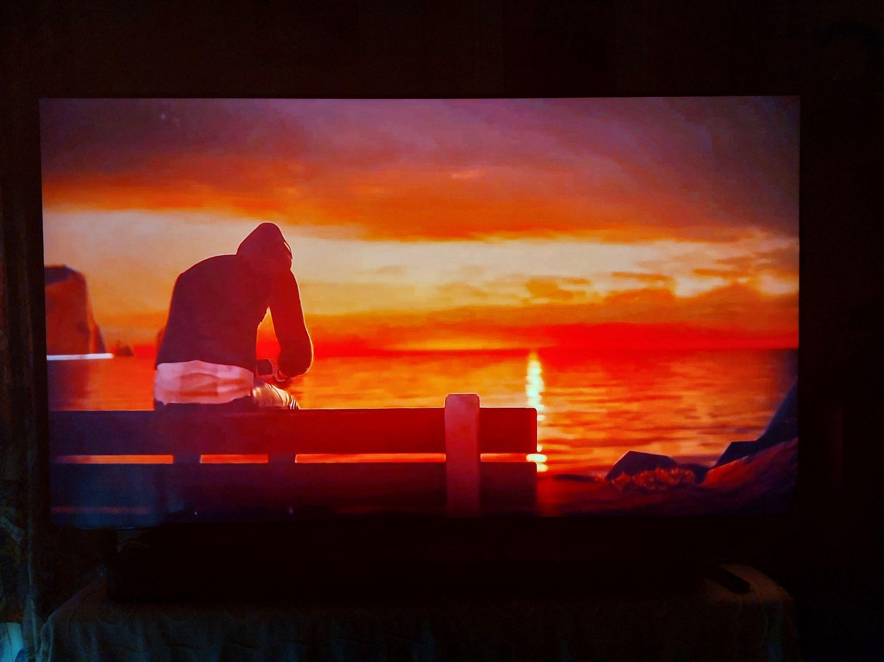
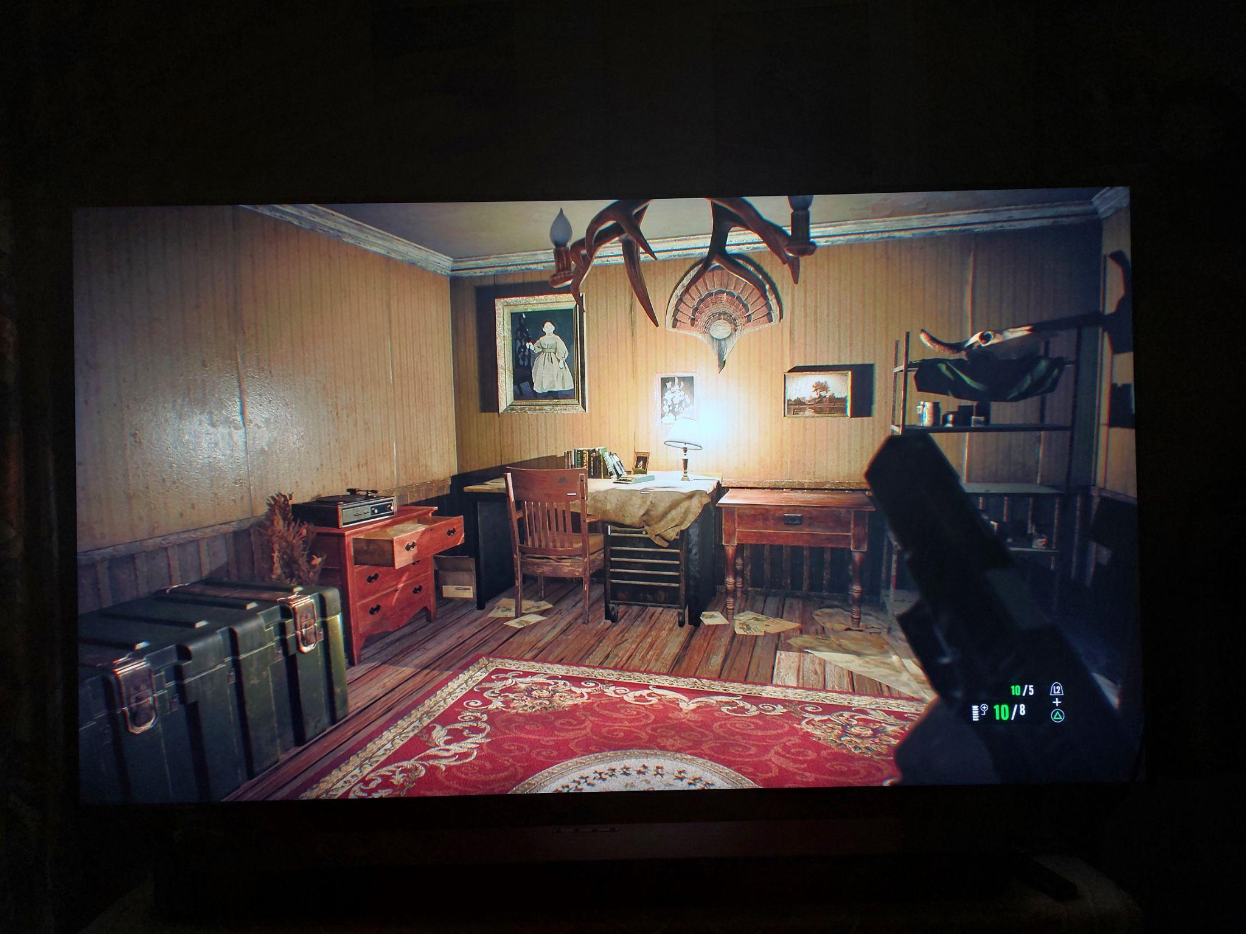
Artwork
-Using lightning and cameras like cinema (or in first person) will let the game create a highly immersive game world.
Notes:
Left photo: camera like cinema (from Life Is Strange)
Right photo: first person (from Resident Evil 7)

Slide 35
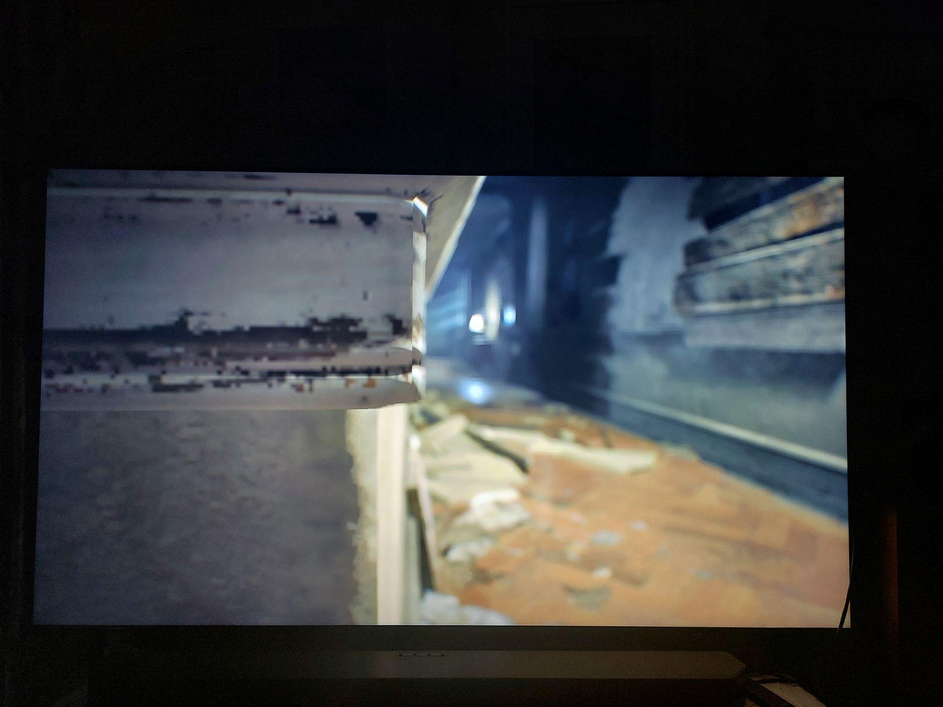
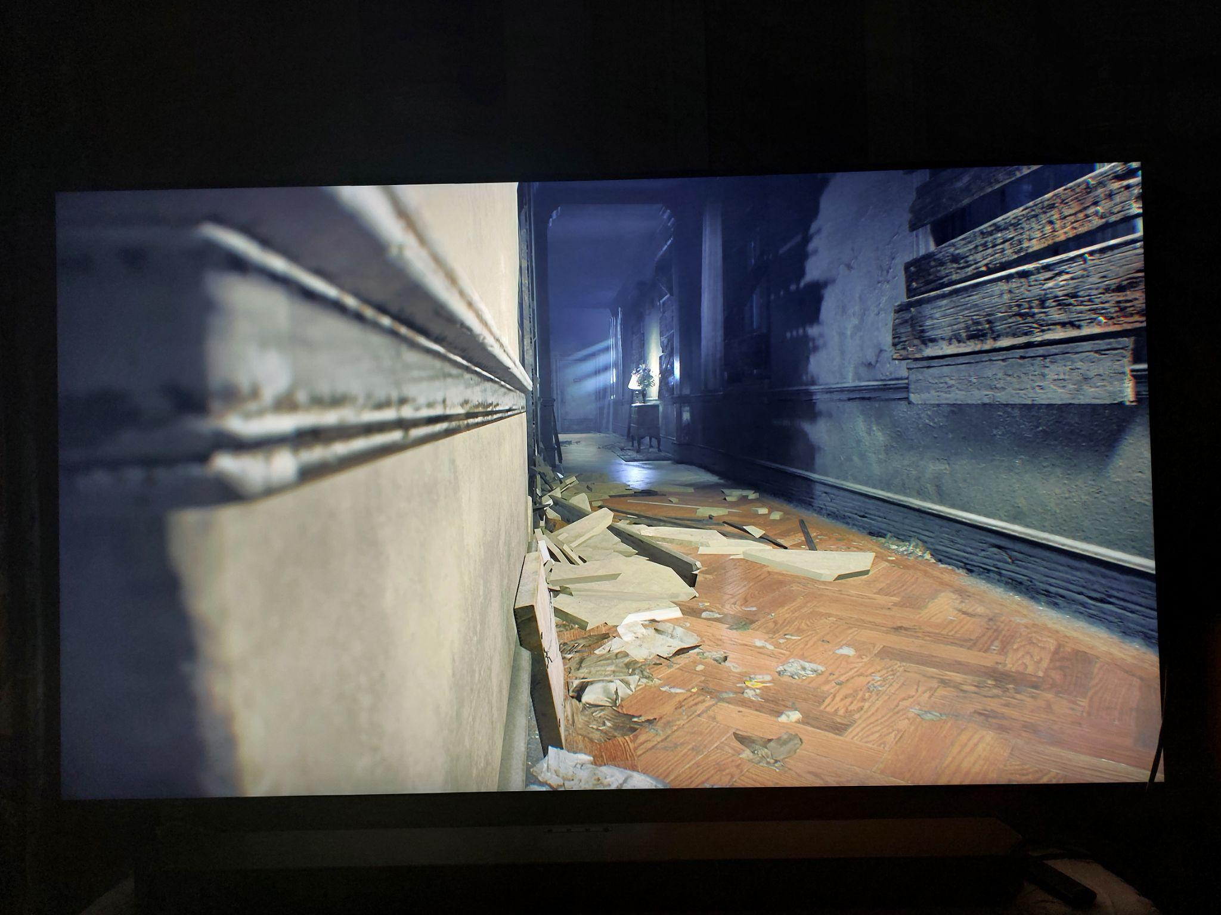
Artwork
-Photography characteristics: depth of view.
Notes:
Photos: without and with depth of view (from Resident Evil 7)

Slide 36
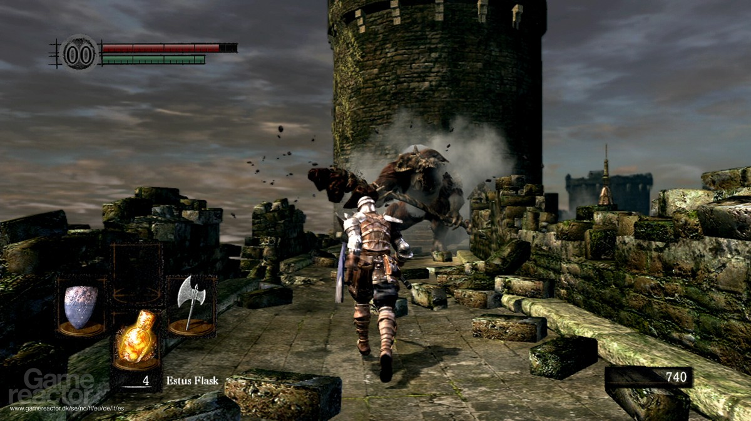
Artwork
The camera that follows the character.
Notes:
Photo: from “Dark souls”. The camera follows the character. Sometimes, the camera is over the shoulder of the character.

Slide 37
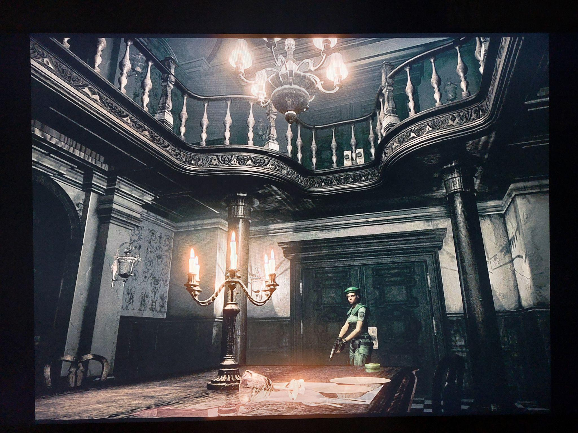
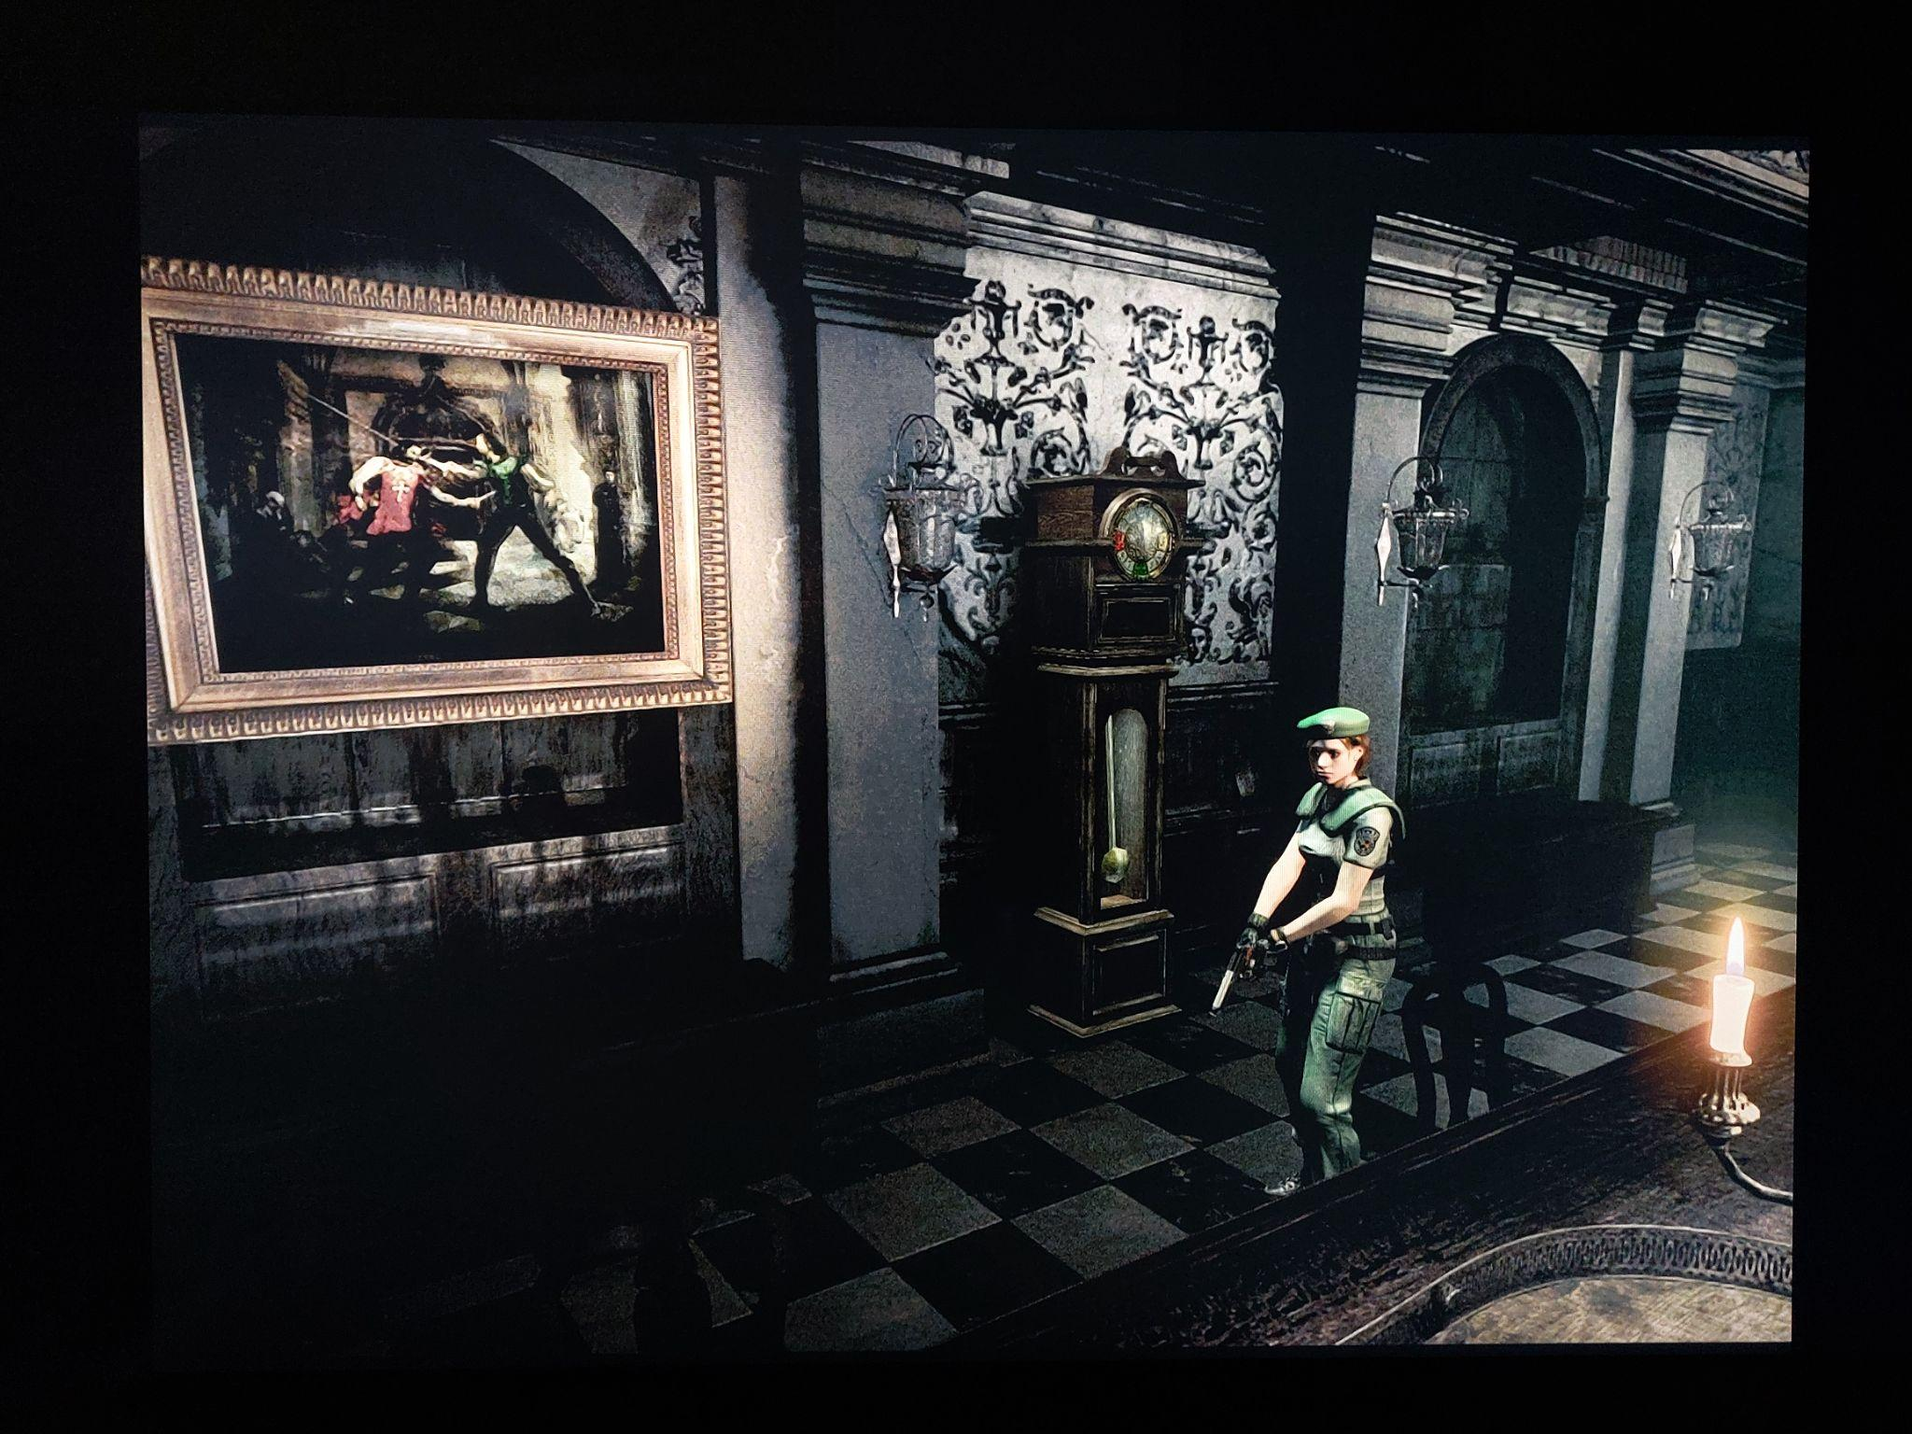
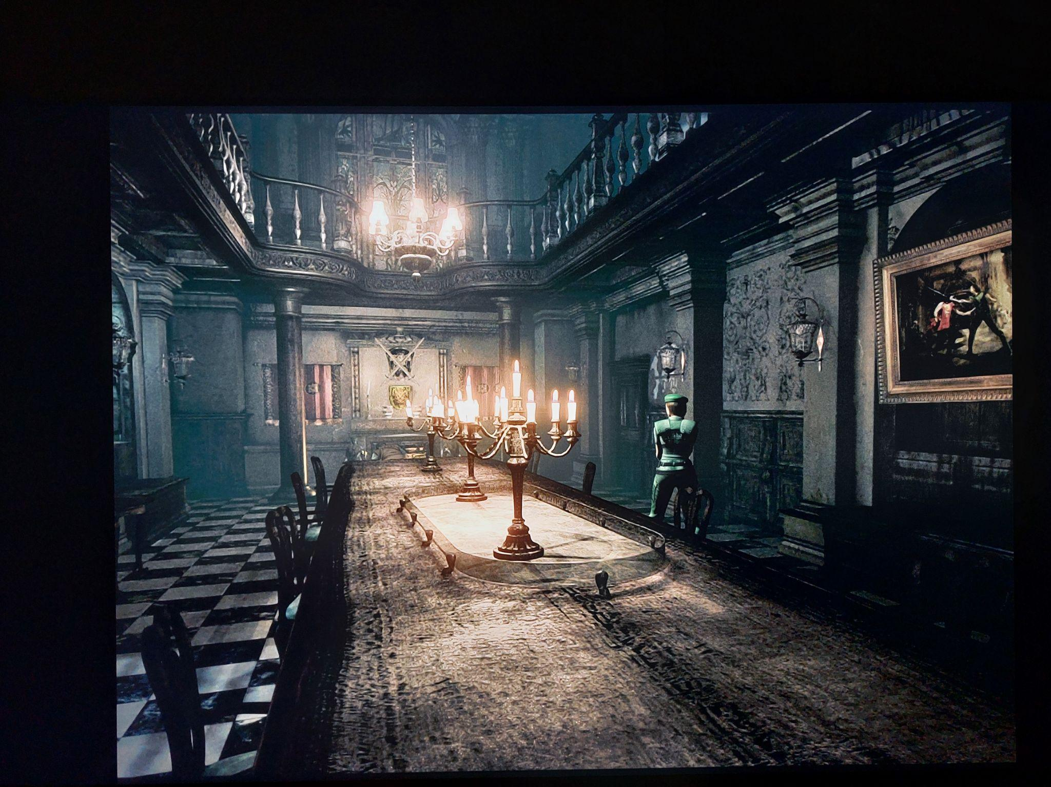
Artwork
Unique camera angles.
Notes:
Photos: Unique camera angles (from Resident Evil HD remastered)

Slide 38
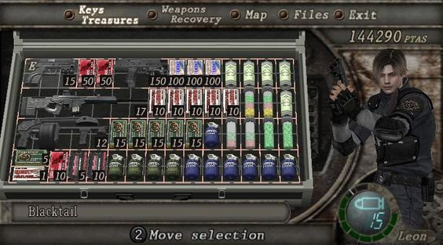
Artwork
Integrate environmental elements and characters within menu to make it more immersive.
Notes:
Photo: in the menu, you see the character (Leon S. Kennedy), and the items you have in a briefcase (from Resident Evil 4 (Original))

Slide 39
Color

Slide 40
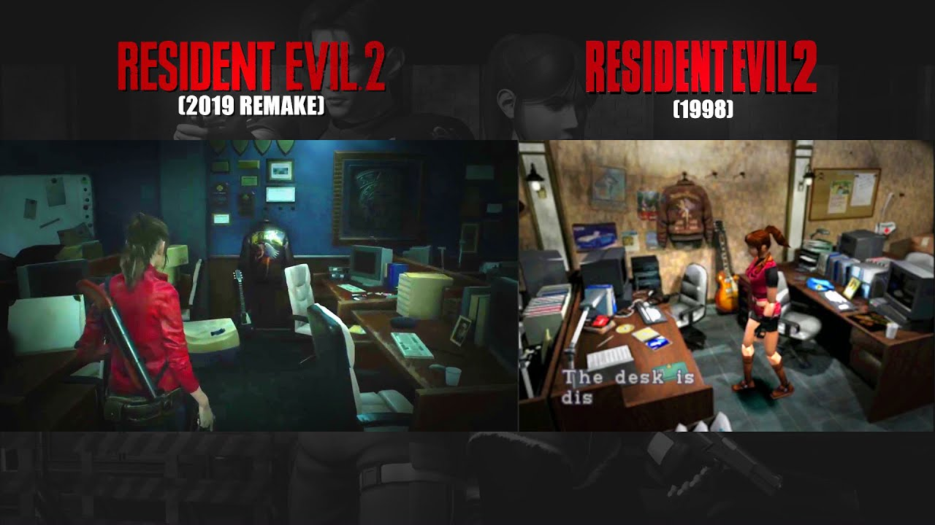
Color
HDR: more colors to more realistic games.
Notes:
Photo: comparative of Resident Evil 2 (1998) to Resident Evil 2 Remake (2019). More colors, more realistic

Slide 41
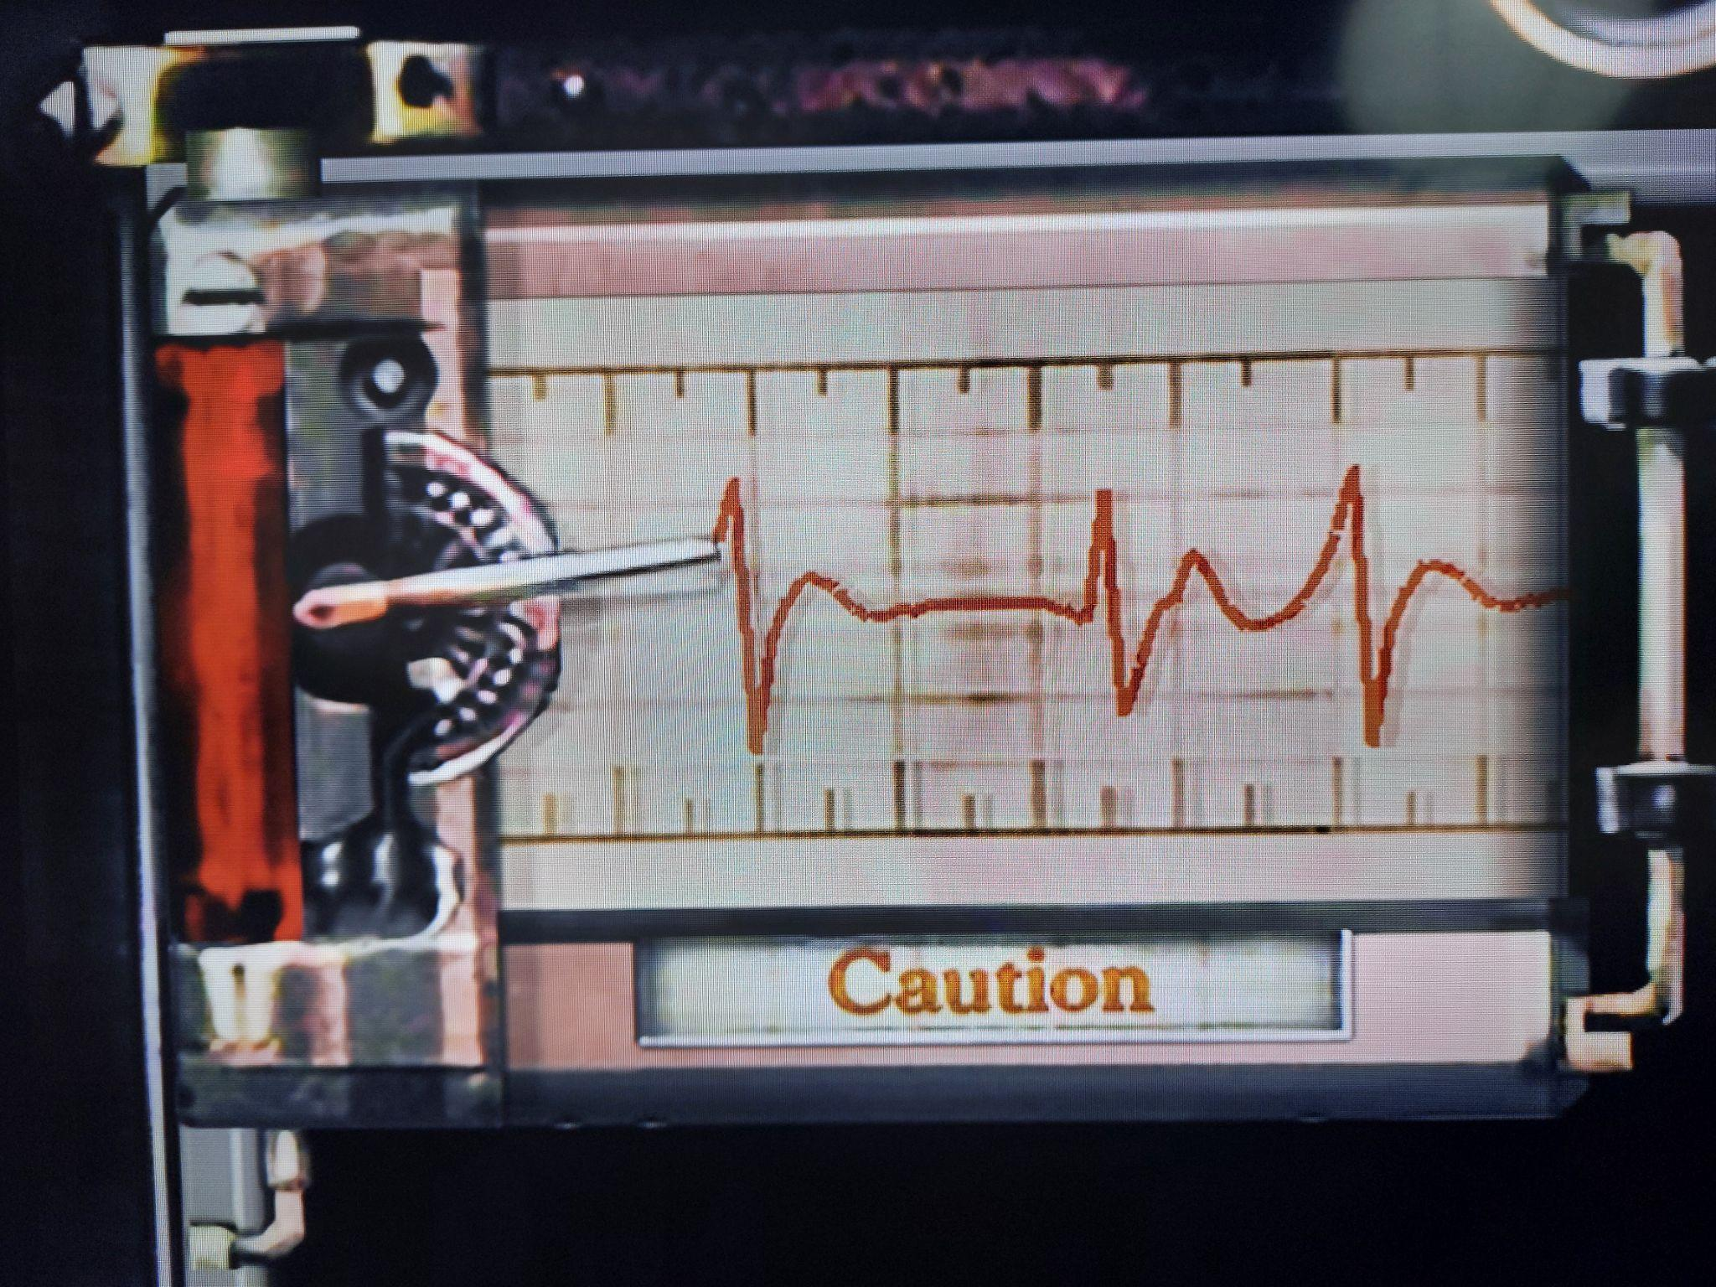
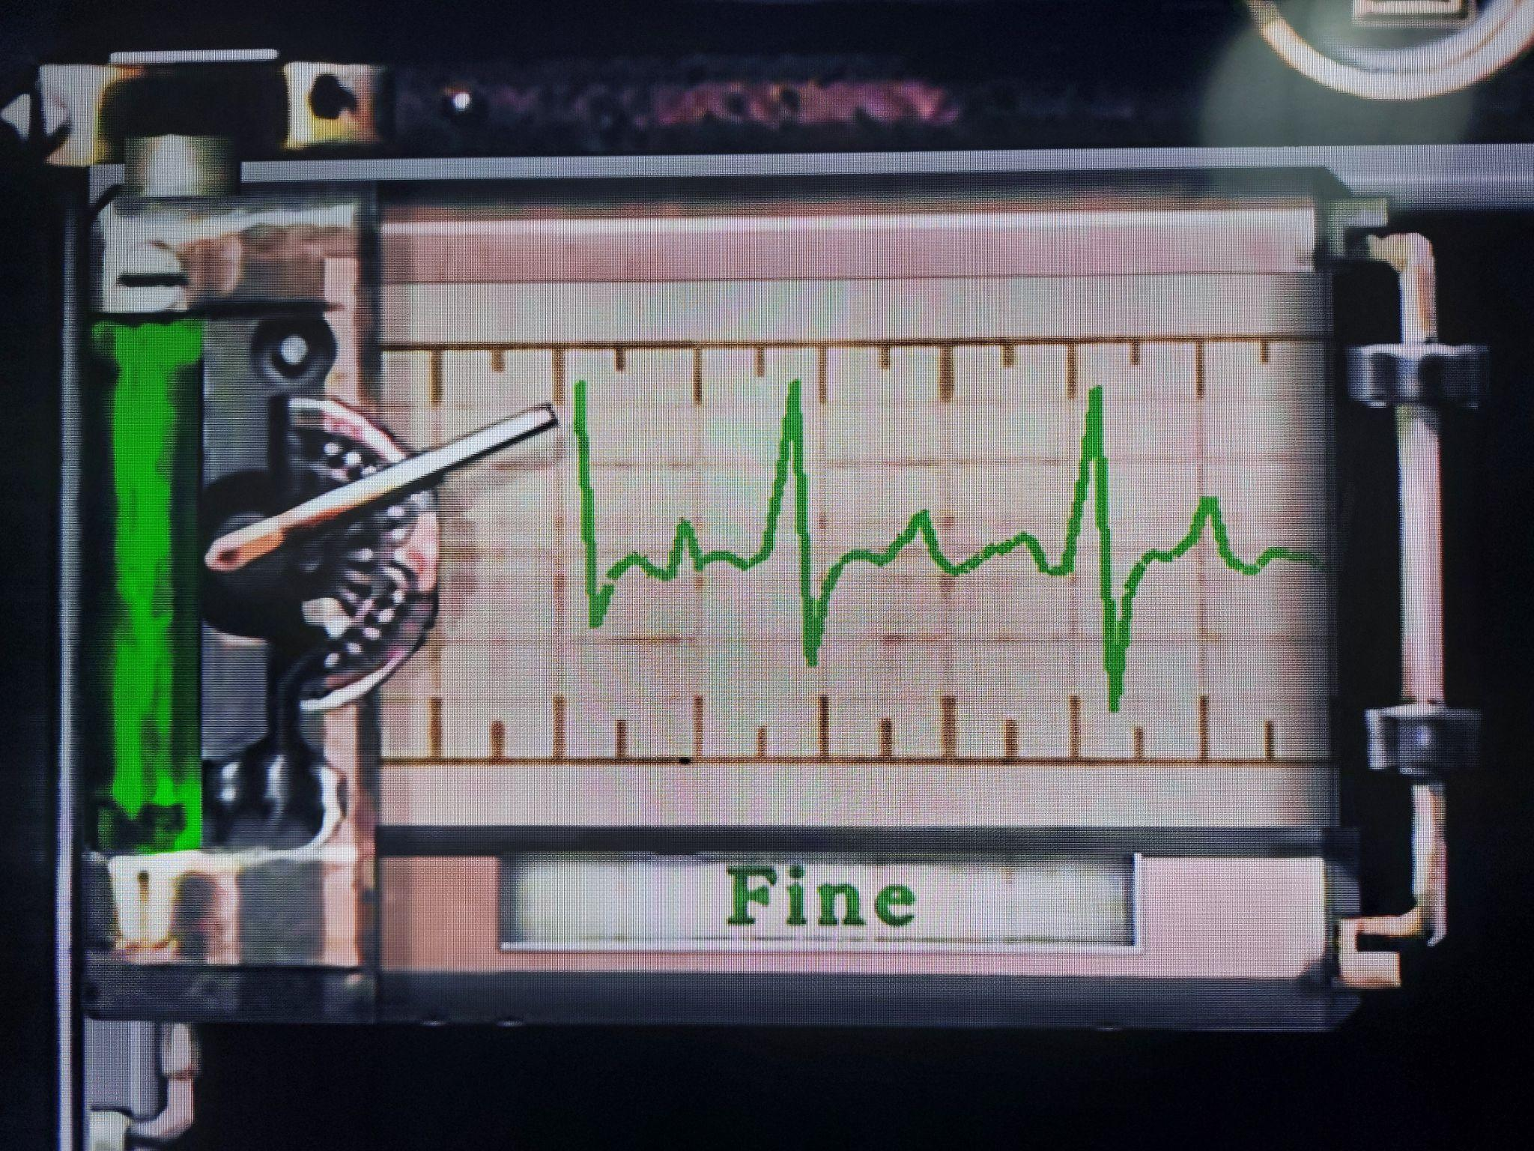
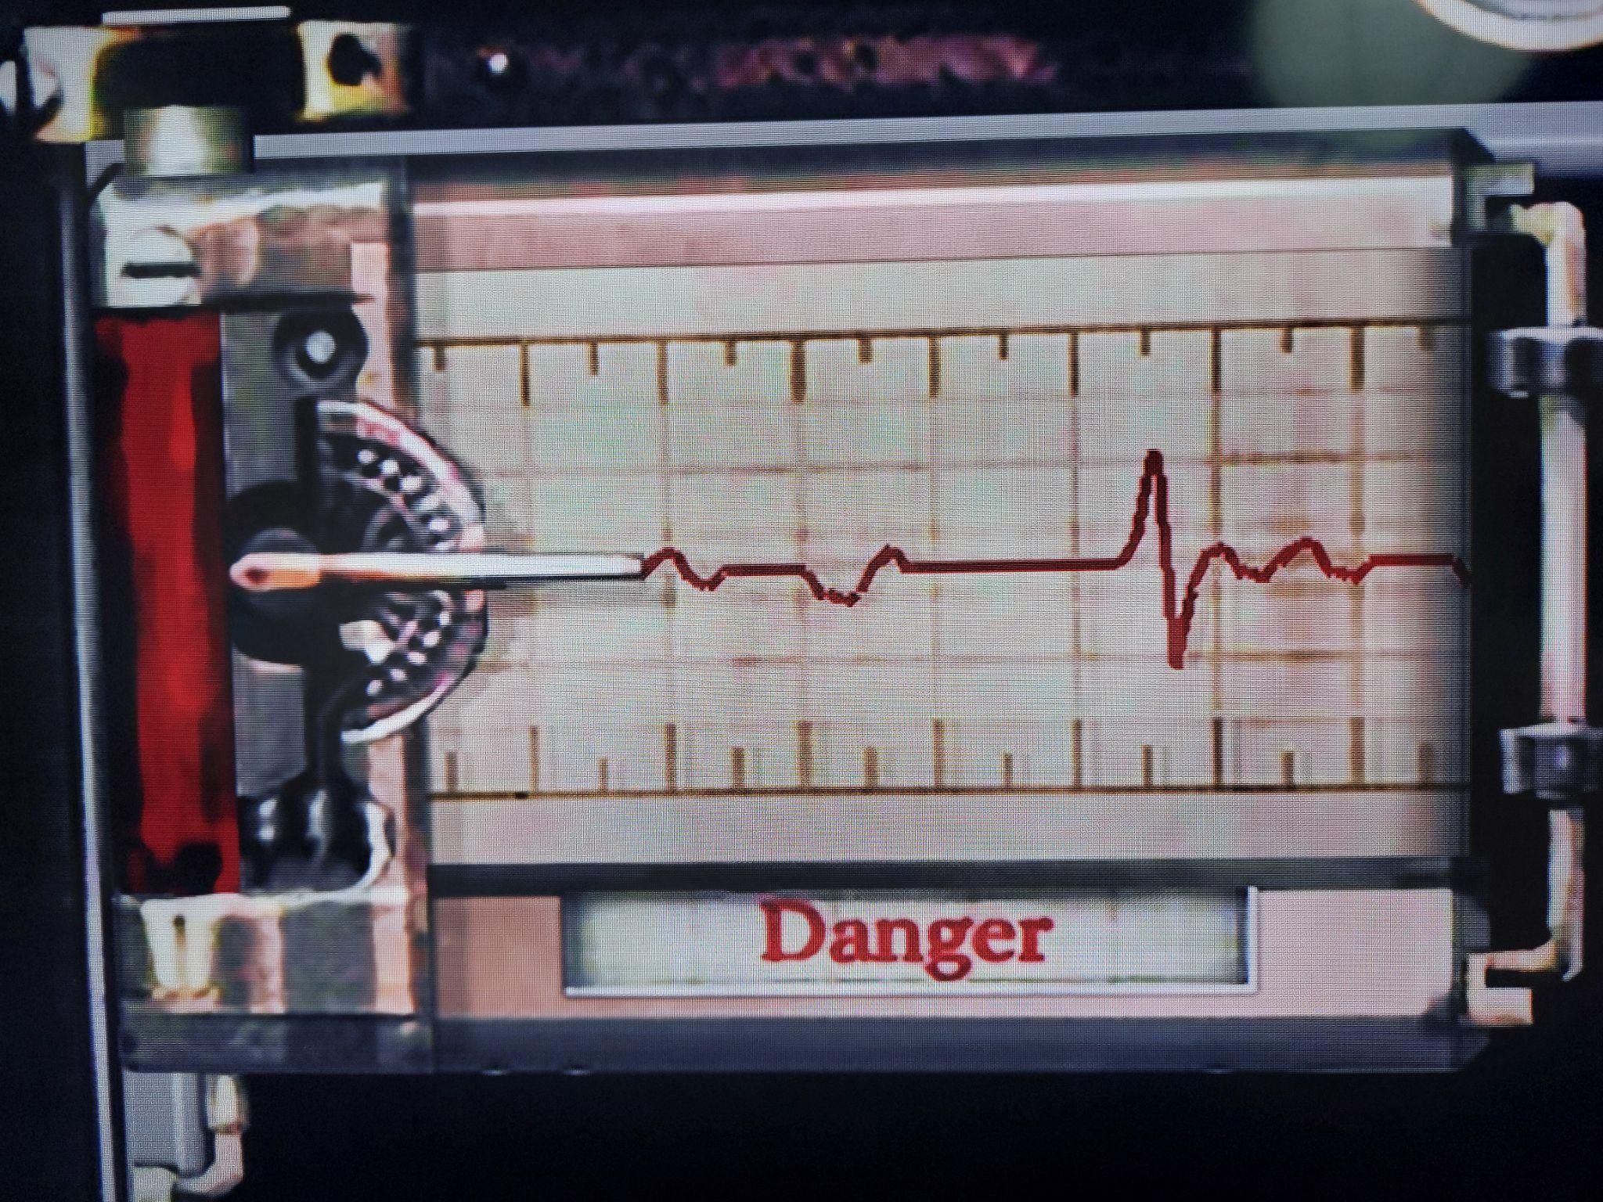
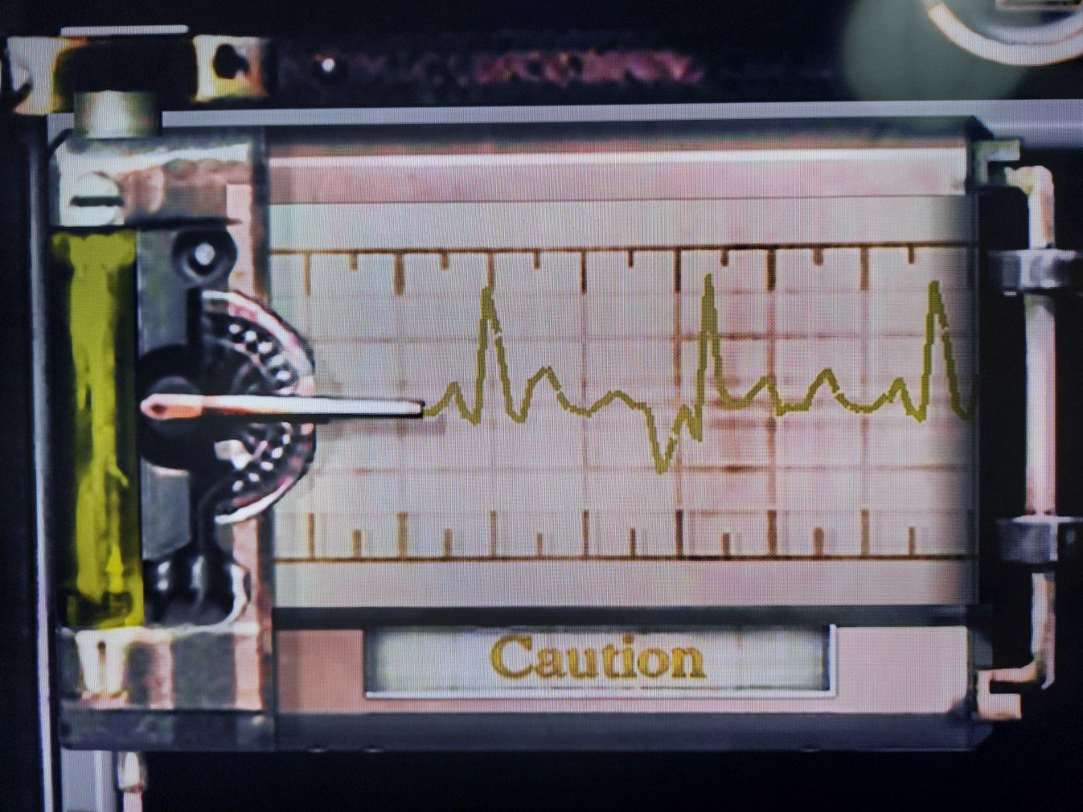
Color
Meaning of colors: green for good, red for bad.
Notes:
Photo: color of life indicator (from Resident Evil HD remastered)

Slide 42
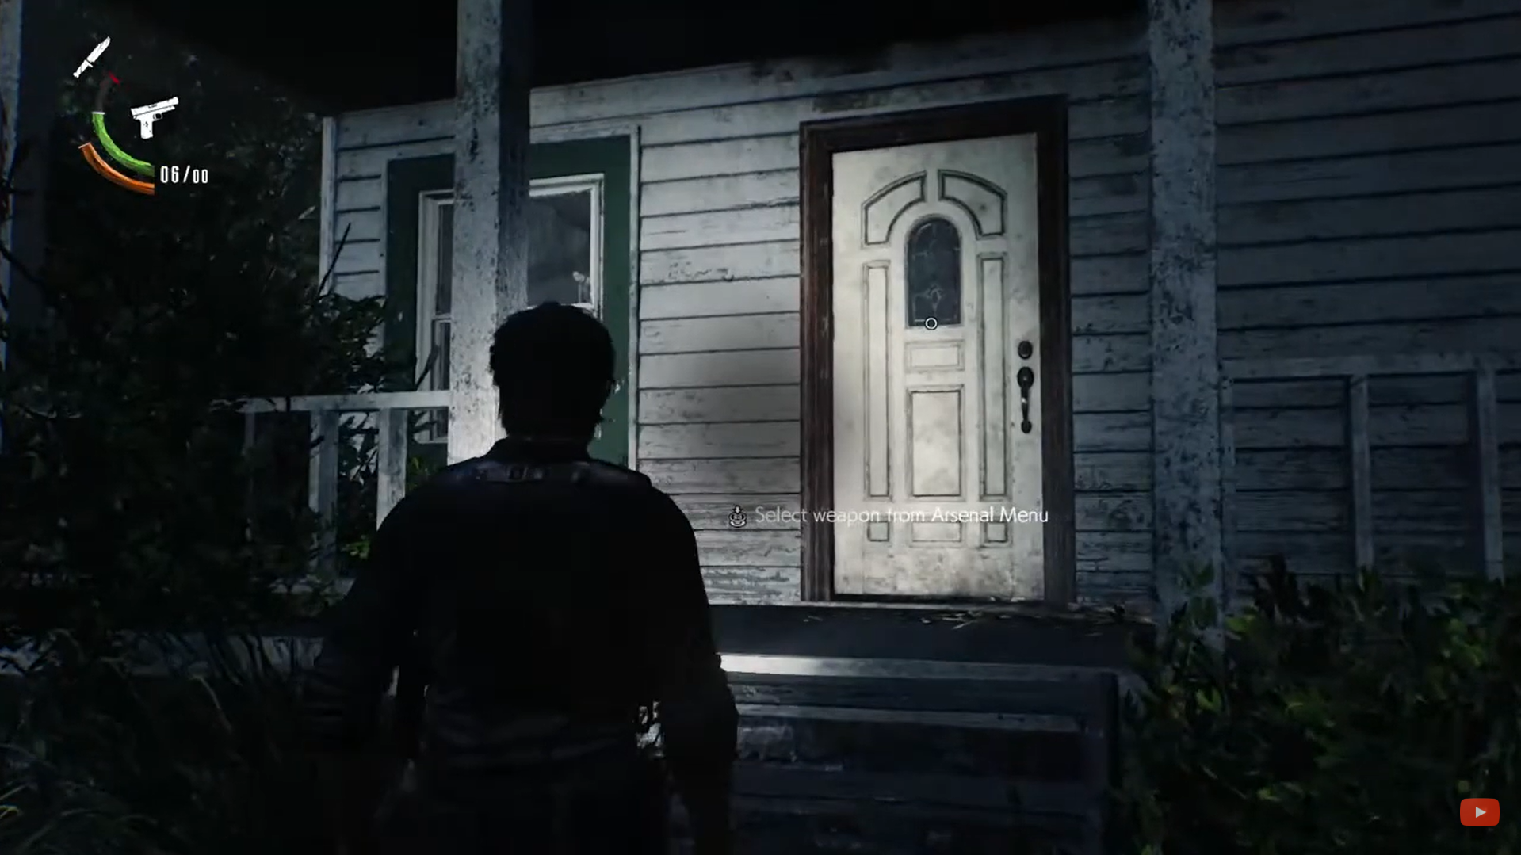
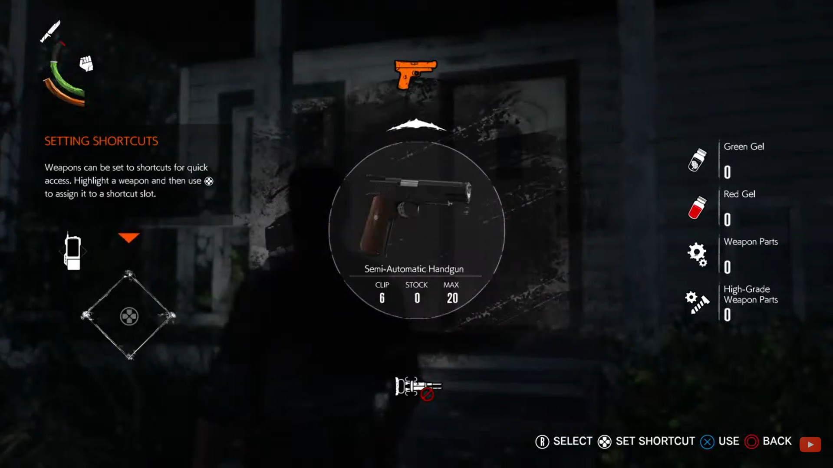
Color
Adjust luminosity and adequate figures to distinguish objects, and to know in which part of the menu you are. Blur and minimize noise to distinguish the menu from the in-game.
Notes:
Photos: in-game vs menu (from The Evil Within 2). In the menu photo, you see the arrow and the orange colour that indicates which item are you in.

Slide 43
Accessibility

Slide 44
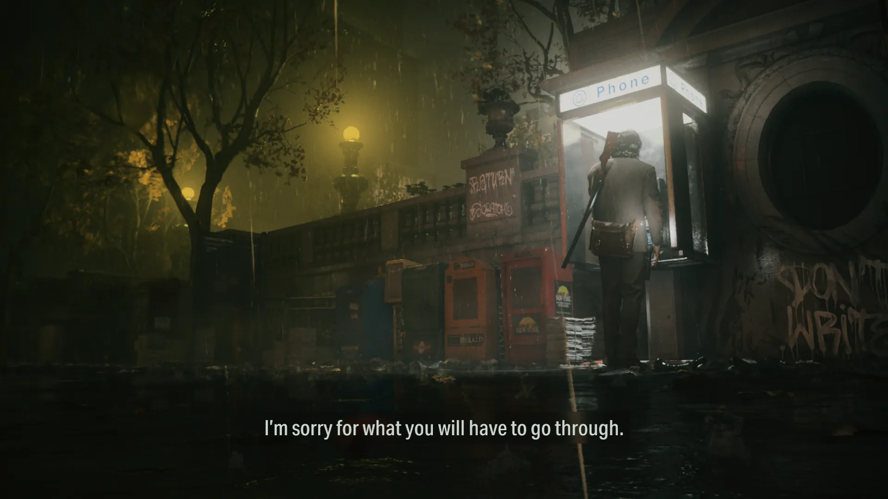
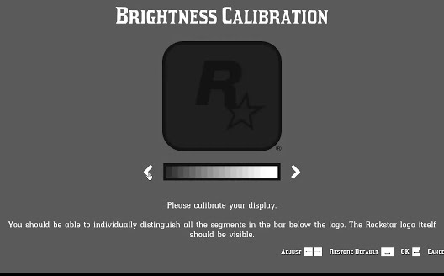
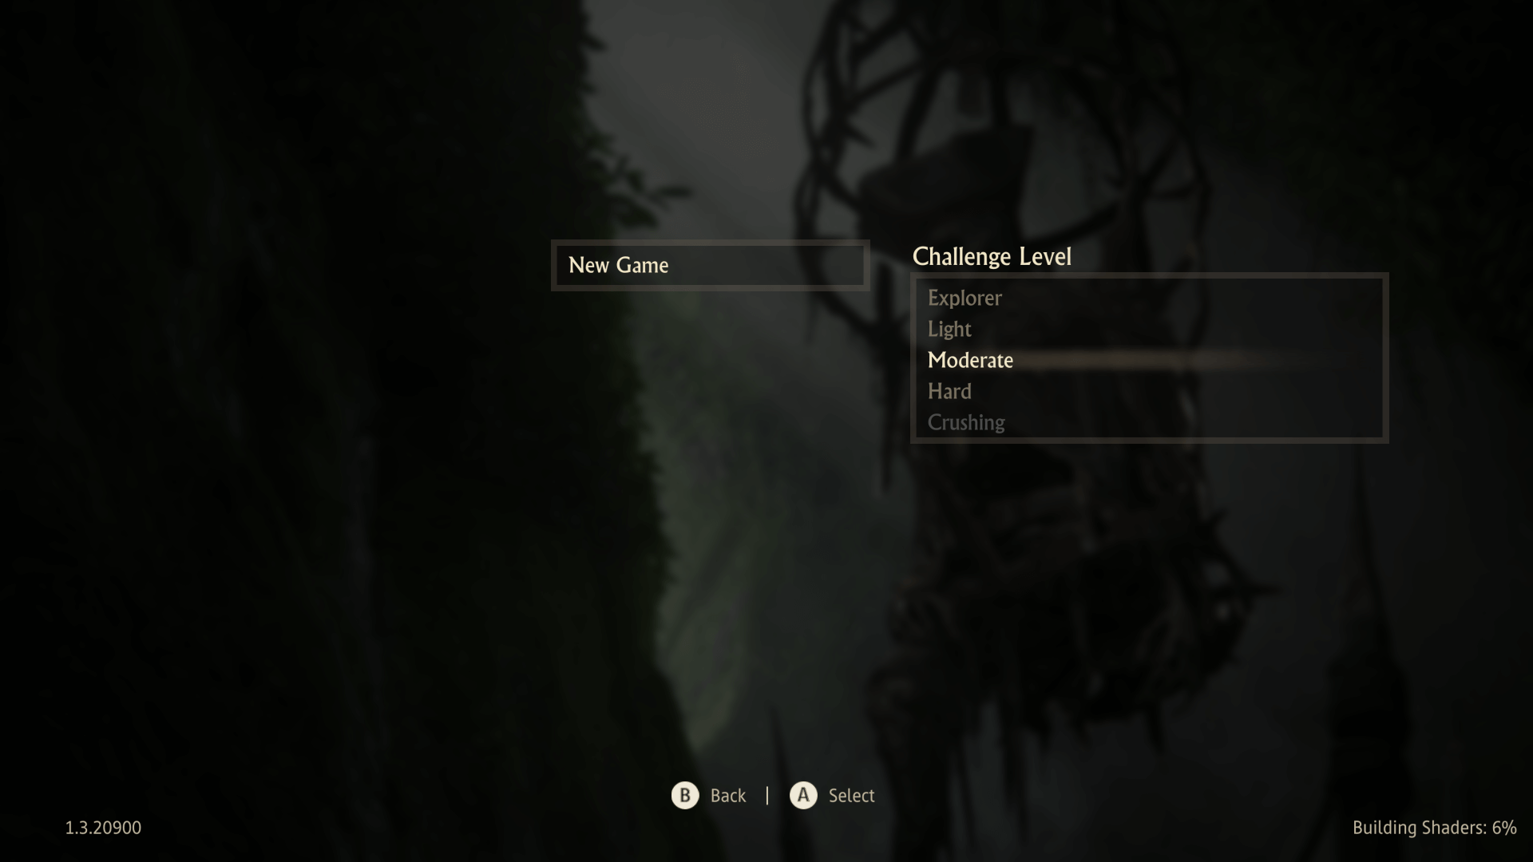
Accessibility
Deaf (subtitles), low vision (audio conversations), disabilities (easy mode and accessibility options), seizure (configure light and contrast), color design to highlight elements and to help color-blinds. The use of controllers designed primarily to meet the needs of gamers with limited mobility.
Notes:
Photo: subtitles (from Alan Wake 2), difficulties (from Uncharted 4), brightness calibration (from Red Dead Redemption 2)

Slide 45
Layout

Slide 46
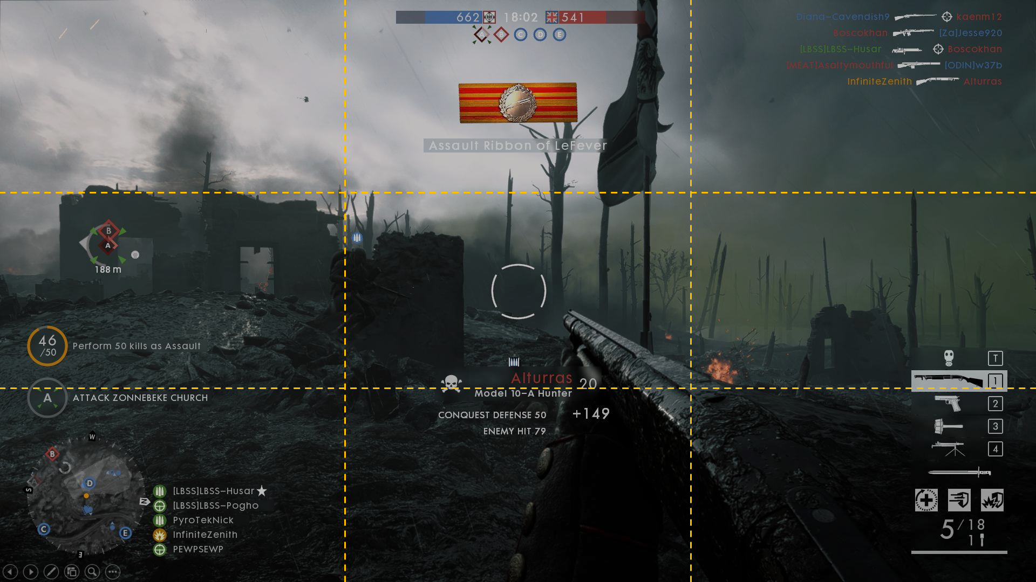
A screenshot from Battlefield One (with the screen segmented into nine rectangles).

Slide 47
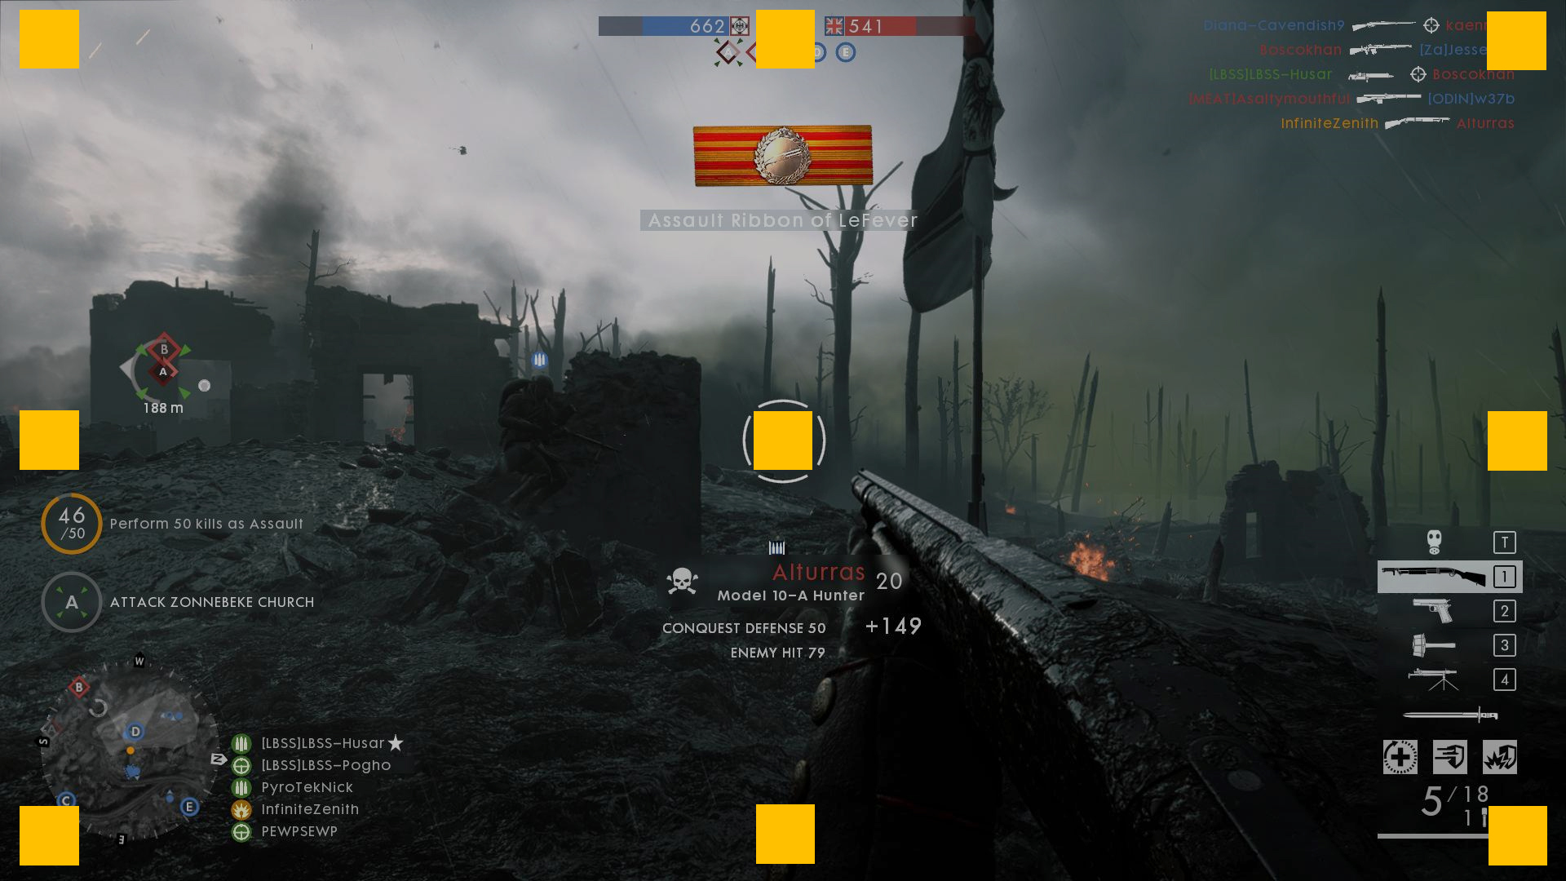
These are called anchor points and they are useful to arrange elements properly.

Slide 48
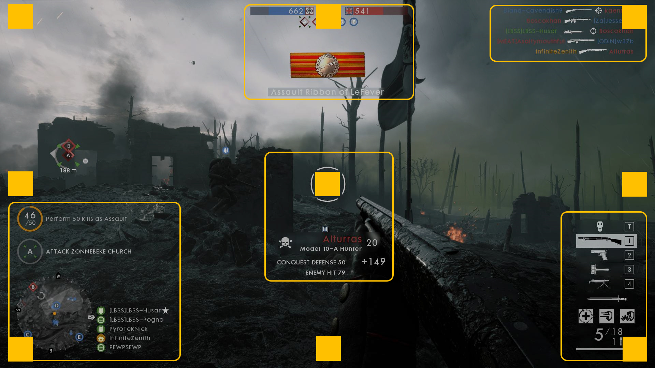
This is the result. Notice that the objects on the left are left-aligned, the objects on the right are right-aligned and the ones in the center are center-aligned.

Slide 49
Menus

Slide 50
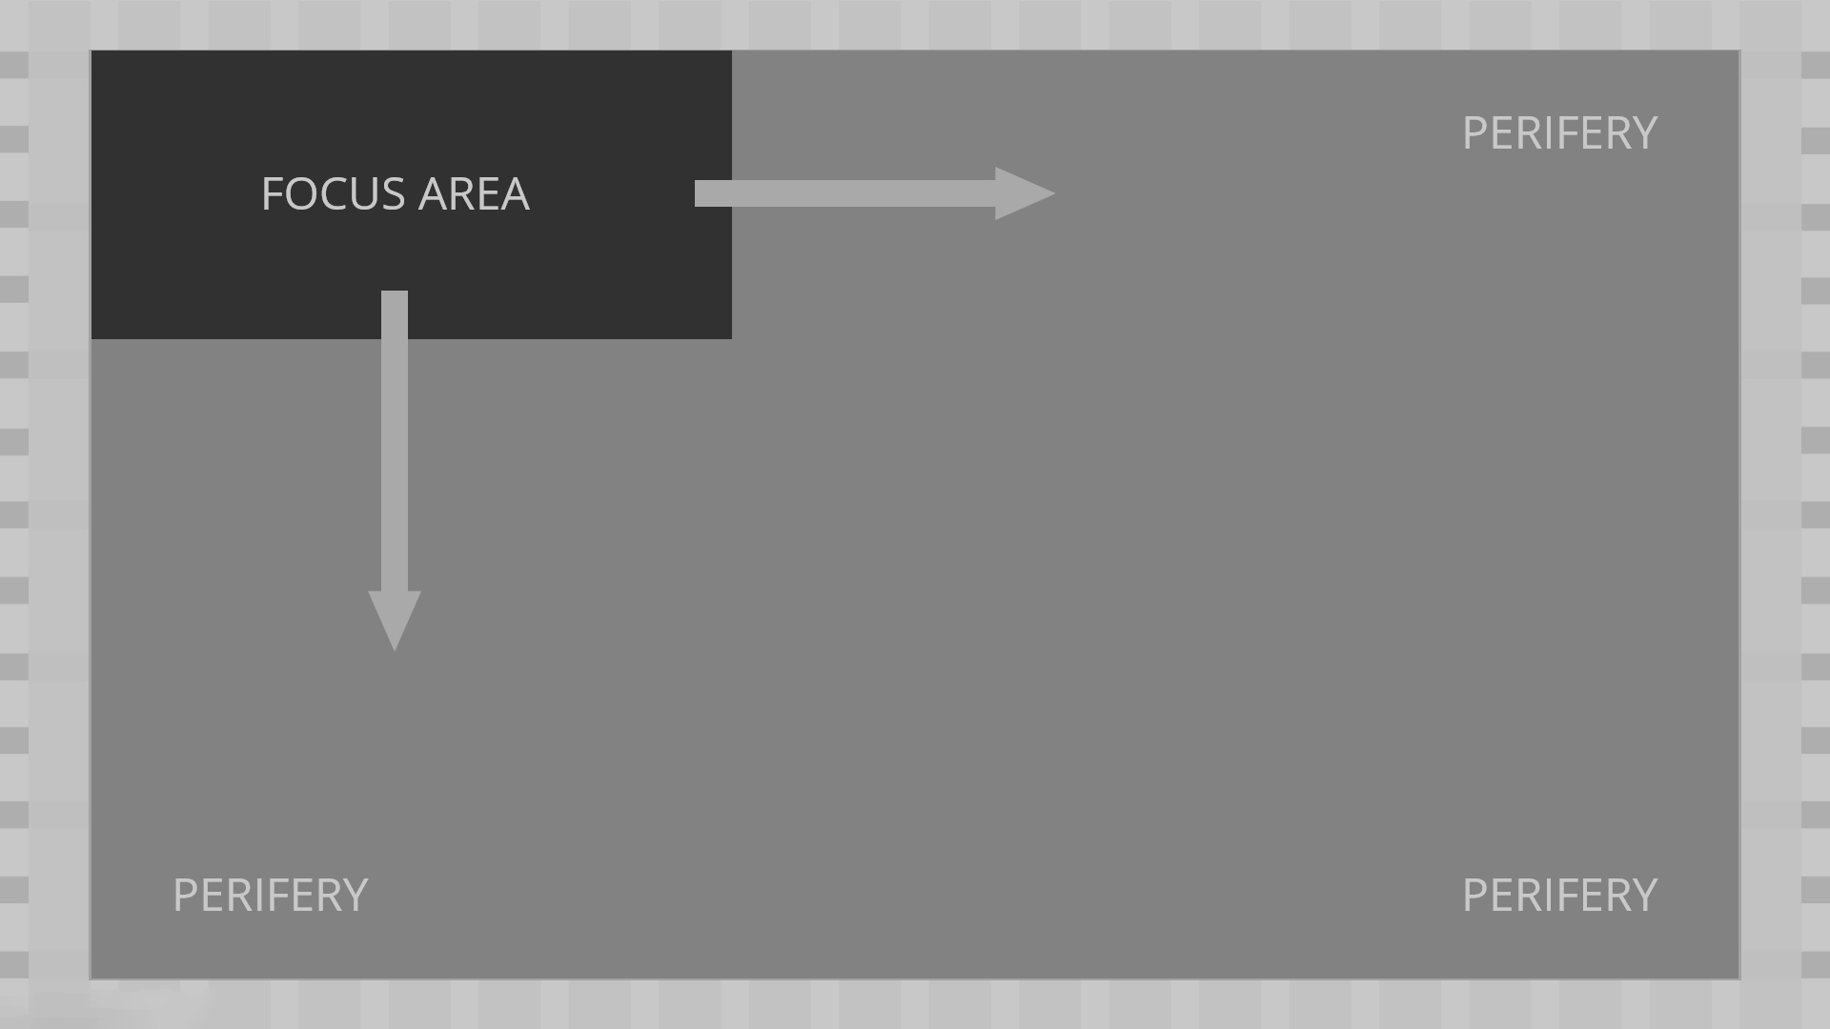
This is the way in which a user focuses on one part and blurs anything else.
This behaviour takes place in a menu usually.

Slide 51
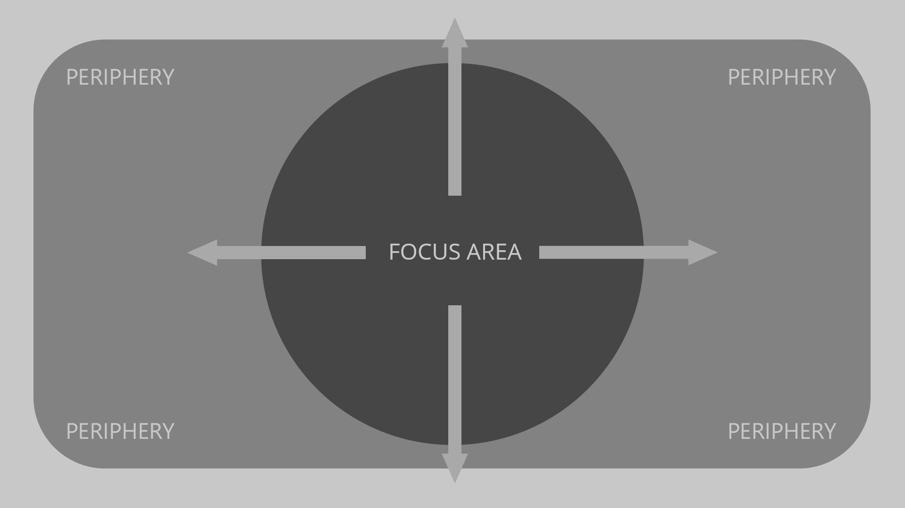
Everything that is not the focus area it’s called negative space. This is where we can put our HUD (minimap, health power bar, ammunition,etc.).
Think of shooter games, for example.

Slide 52
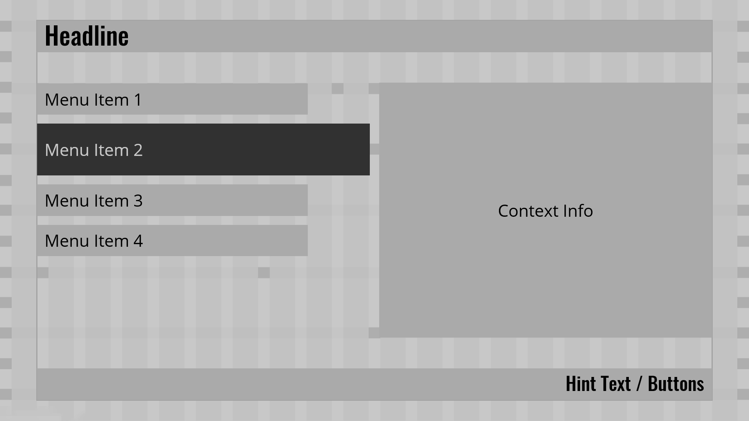
It’s also a good idea to have a template.
This is a menu and the user inspects it from top left downwards as we have already seen (focus area).

Slide 53
Mockups

Slide 54
Marketplace mockups.
Static mockups.

Slide 55
How to create the right environment
Celebrate the user every time he/she makes a purchase.
The less steps the purchase has the better.
Do not overwhelm the user with information. Instead, show some good visuals and vital information.
Have the option of purchasing from the game not having to go through the store.
Remember that the user can back out at any moment.

Slide 56
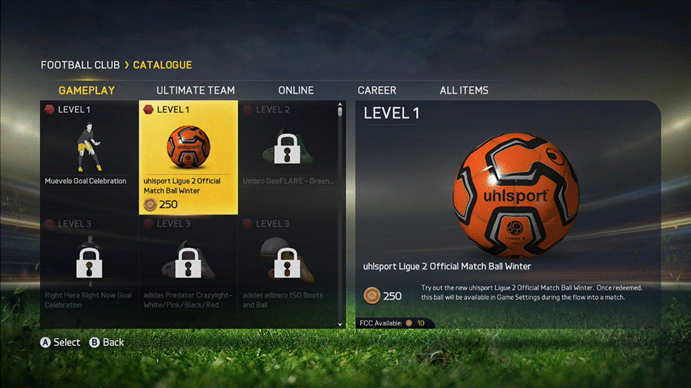
Screenshots include: Forza, Fifa, Killer Instinct.

Slide 57
Marketplace mockups.
Static mockups.

Slide 58
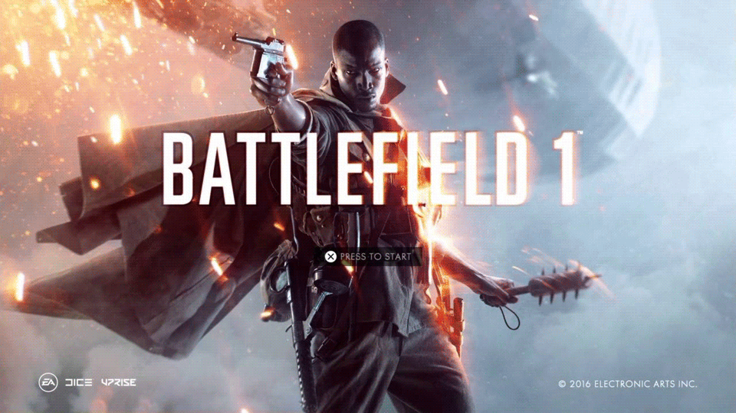
Title Screen
Screenshots from Crysis 3, Metal Gear Online, Battlefield 1

Slide 59
HUD

Slide 60
HUD Components.
2. HUD Design.

Slide 61

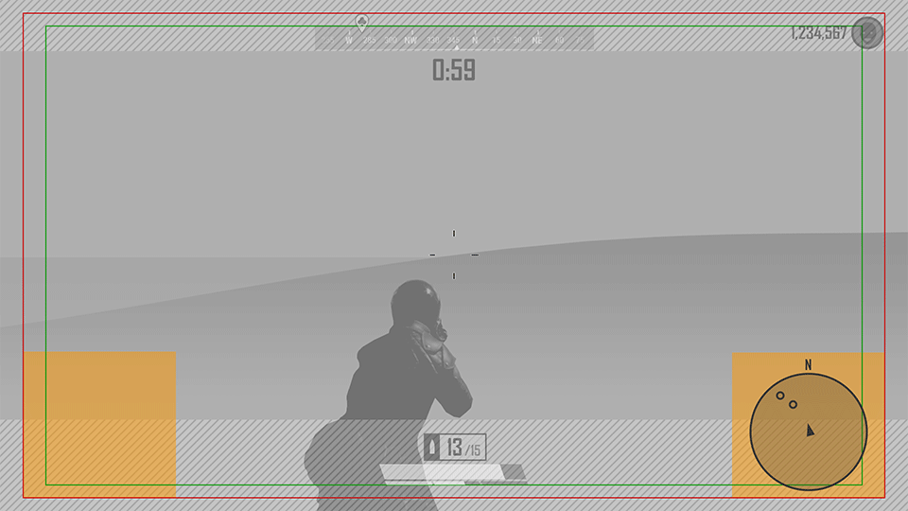
HUD Components
The main information is layered in order to be easier to keep track of it, without interrupting the main experience of the gameplay.
Health is usually shown as a number, icon, bar…These could change colors depending on whether the player gains or loses health.
Minimap

Slide 62
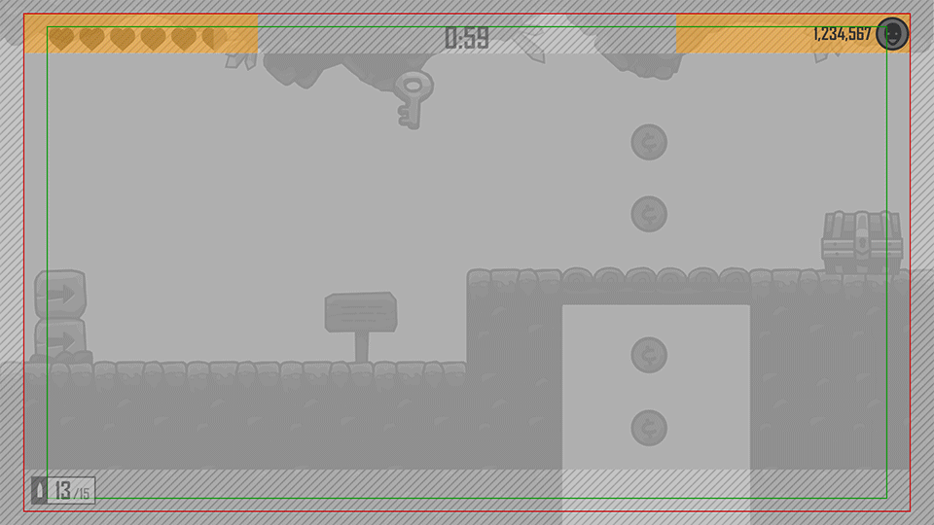
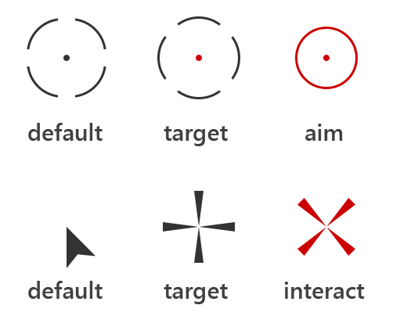

Score offers various stats like points, progression, and high score, providing feedback to the player during the game.
The reticle is used for targeting, direction, or interaction with the game world, and changes color to indicate effects like hitting a target.
Timers often accompany the score, alerting players with flashing colors or sounds when time is running out.

Slide 63
HUD Components.
2. HUD Design.

Slide 64

HUD Design
The HUD varies depending on the context of the game. It can switch between first, second, or third-person views, with a reticle in the center and vital information in the corners, or have a fixed top-down view with information on the screen's perimeter.
Notes:
Game shown: Dead Space 1

Slide 65

Driving and Flying

Slide 66

Action and Shooters

Slide 67

RTS and Simulation

Slide 68

Platform Games

Slide 69

Fighting Games

Slide 70

Sports

Slide 71
Typography and UI Principles

Slide 72
Typography Basics & Font Selection.
Optimize Contrast & Alignment.
UI Types & Usability Principles
State Changes & Page Flow

Slide 73

Typography Basics & Font Selection
Typography: x-height and counters improve readability.
Font Selection: Use full font families with multiple weights (bold, italic) and avoid trendy fonts.

Slide 74


Optimize Contrast & Alignment
Contrast: Aim for 4.5:1 to 7:1 ratio.
Alignment: Left-align text and use proper word wrapping (60-120 characters per line).

Slide 75


UI Types & Usability Principles
Diegetic: UI integrated into the game world.
Non-Diegetic: UI over gameplay.
Usability: Limit items to 7 per screen, 3 levels per menu, clear button affordances.

Slide 76

State Changes & Page Flow
State Changes: Normal, Disabled, Selected.
Page Flow: Design from top-left to bottom-right.
Key Takeaways: Consistency, readability, and simplicity.

Slide 77
To conclude
All this time, we have played video games, perceiving and interacting with interfaces, without calling them like that, but they have been always there.
Design rules and standards in video games exist for a reason.

Slide 78


THANKS FOR YOUR ATTENTION!
Notes:
Left photo: from “Super Mario Bros”, at the end of a world from 1 to 7, when we find a Toad.
Right animation: from “Super Mario 64”, the part of the “infinite stairs”.

